Slide 1
Model Selection in
Parameterizing Cell Images and Populations
MMBIOS, April 2015
Gregory R. Johnson

Slide 2
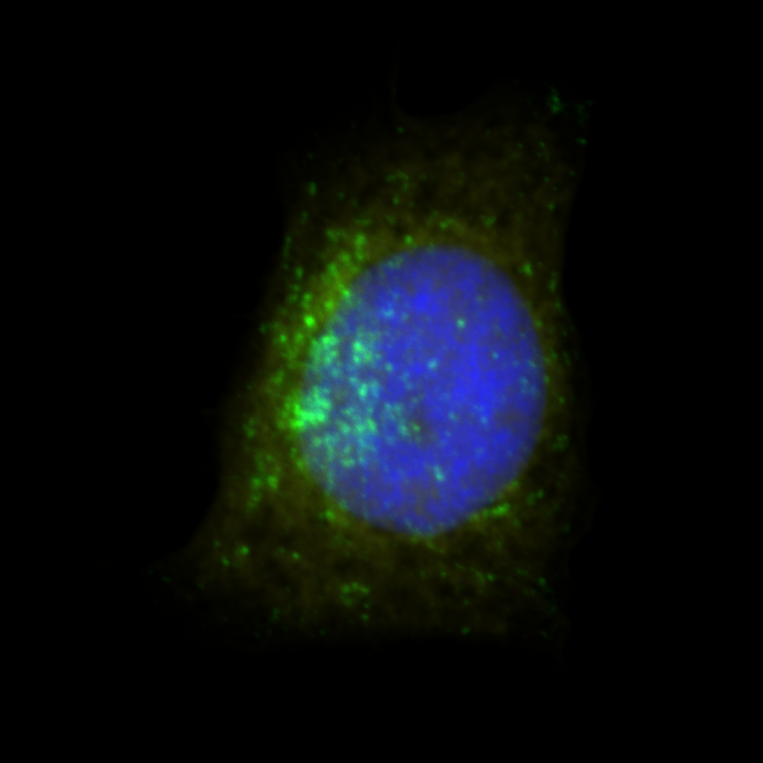
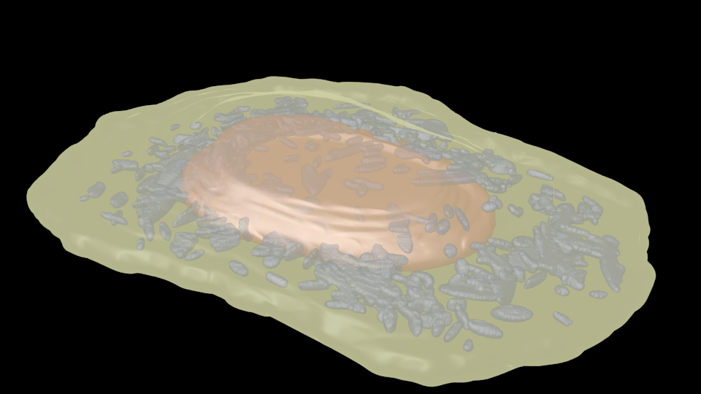
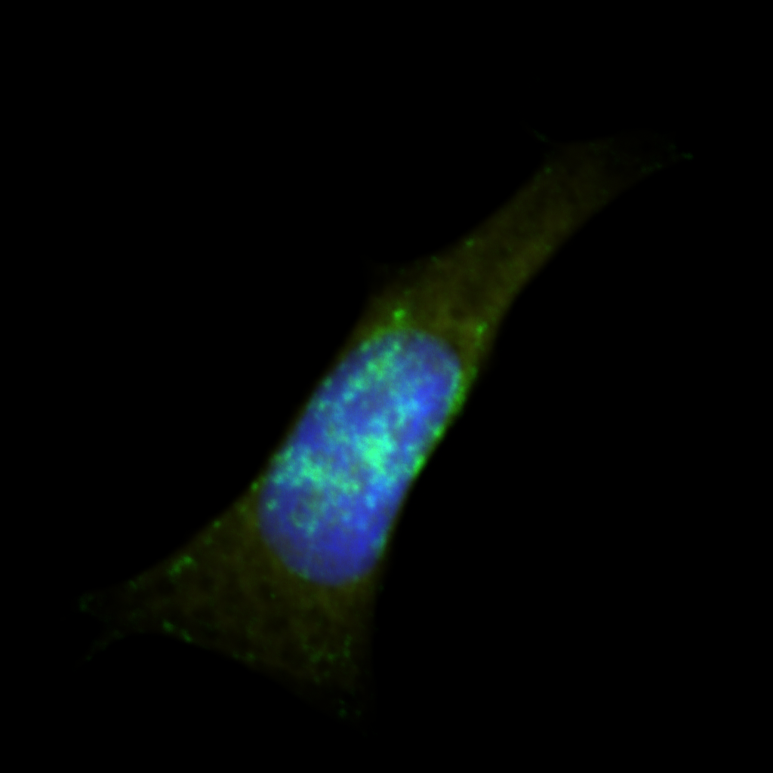
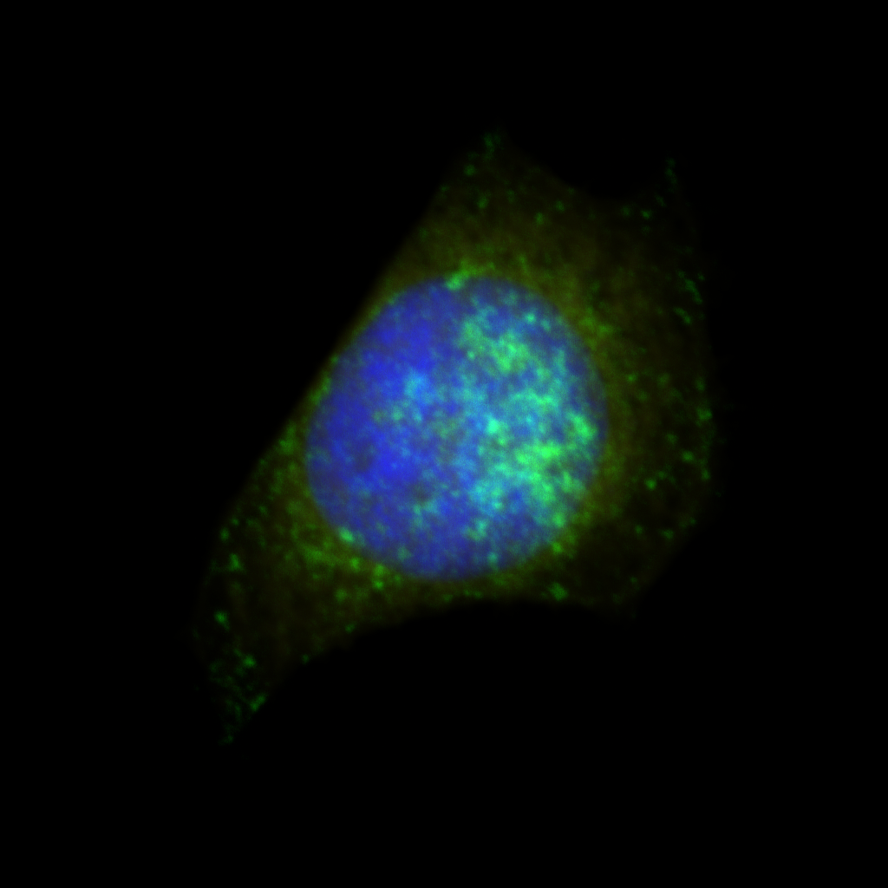
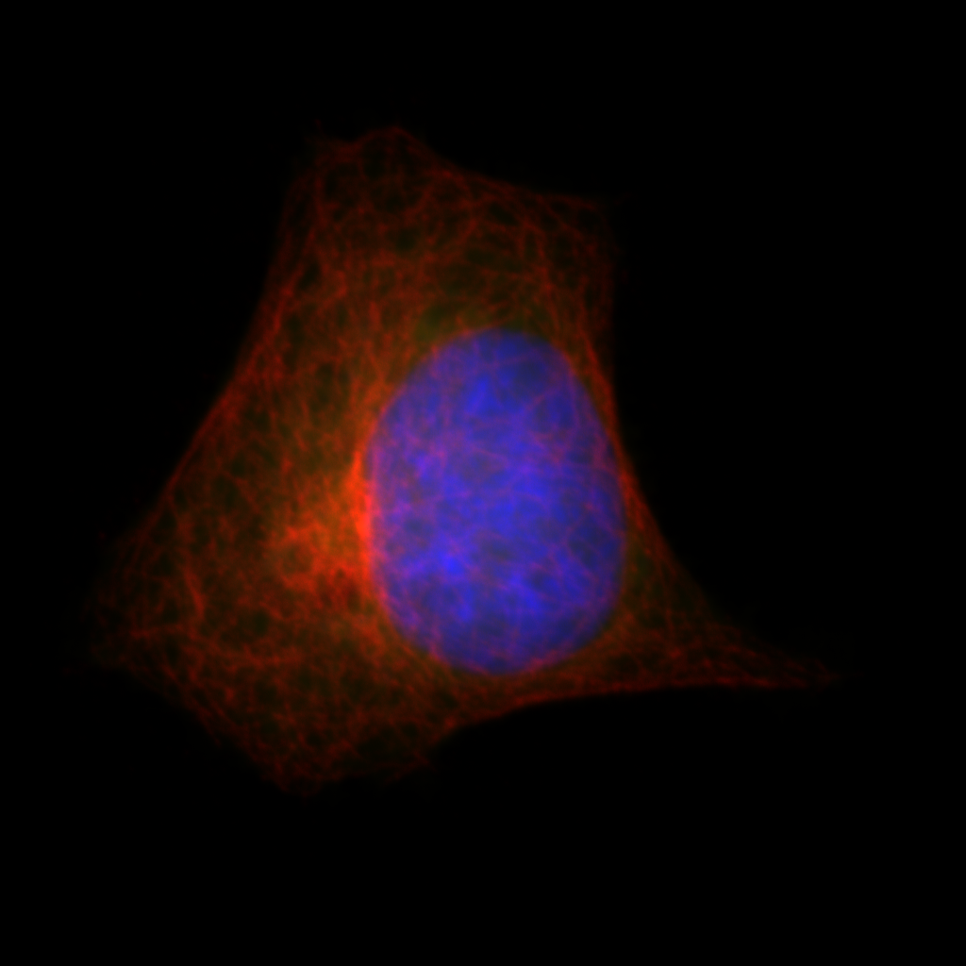
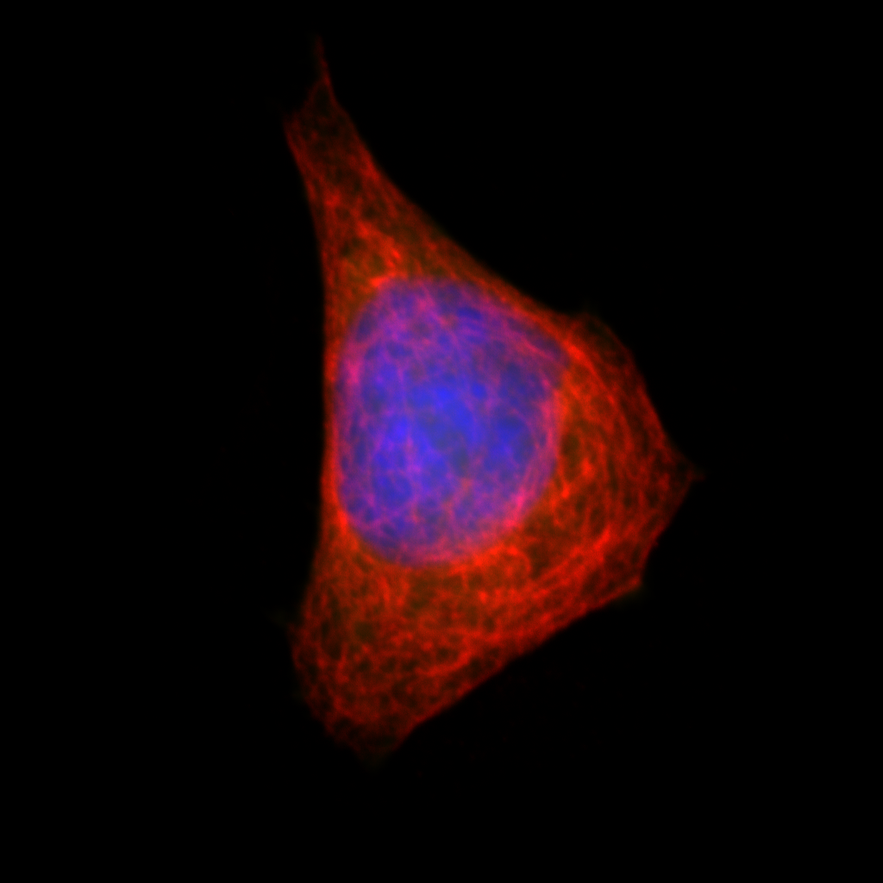
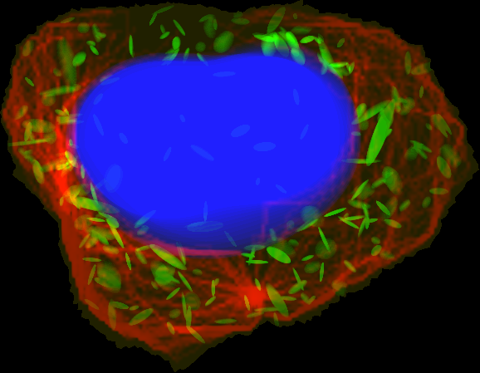
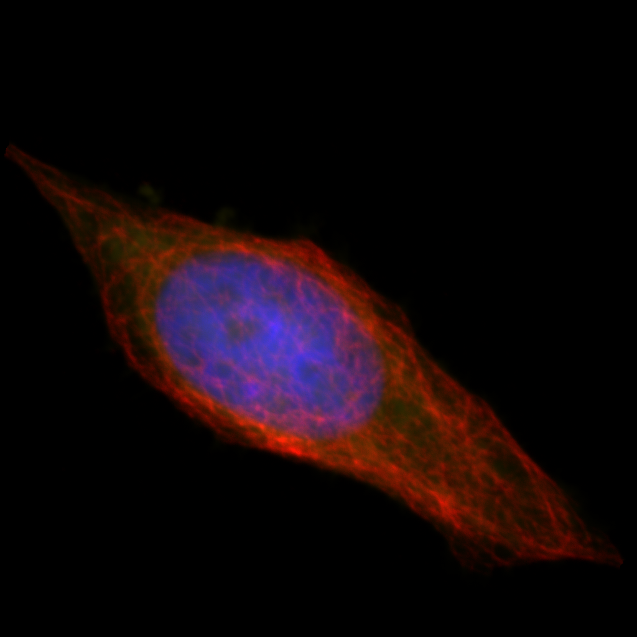
CellOrganizer
Cell
Images
Model Parameters
Synthetic
Images
Nuclear shape
Cell shape
Training
Synthesis
Object pos. probability
Microtubule distribution
Object appearance
Object positions
Object number
Object distribution
Notes:
This slide illustrates the central concept of our work in generative modeling.
Here we construct models for cell components learned for many cell instances and combine them into a statistical model such that we can sample from that model to obtain new parameter values that we use to synthesize new cell instances

Slide 3
CellOrganizer Models Cell Populations
Learn how spatial relationships of cell compartments vary across cell populations
Generate high-quality in silico representations (i.e. images) cell shape and the relationships of compartments within them
Images
Parameterizations
X₁
p₁
Sampled
Parameterizations
Synthesized
Images
X₂
p₂
p₁*
x₁*
P(p_{i}|Ɵ)
X₃
p₃
p₂*
x₂*
X₄
p₄
…
…
p_{m}*
x_{m}*
…
…
Cell Morphology
Distribution
X_{n}
p_{n}
f(x) = p
d({p₁,…,p_{n}}) = Ɵ
b(Ɵ) = p*
g(p) = x

Slide 4
CellOrganizer Models Cell Populations
Represent cell morphology and organization of components in an invertable, compact manner
Learn a distribution over these compact parameterizations
X₁
p₁
Sampled
Parameterizations
Synthesized
Images
X₂
p₂
p₁*
x₁*
P(p_{i}|Ɵ)
X₃
p₃
p₂*
x₂*
X₄
p₄
…
…
p_{m}*
x_{m}*
…
…
Cell Morphology
Distribution
X_{n}
p_{n}
f(x) = p
d({p₁,…,p_{n}}) = Ɵ
b(Ɵ) = p*
g(p) = x

Slide 5
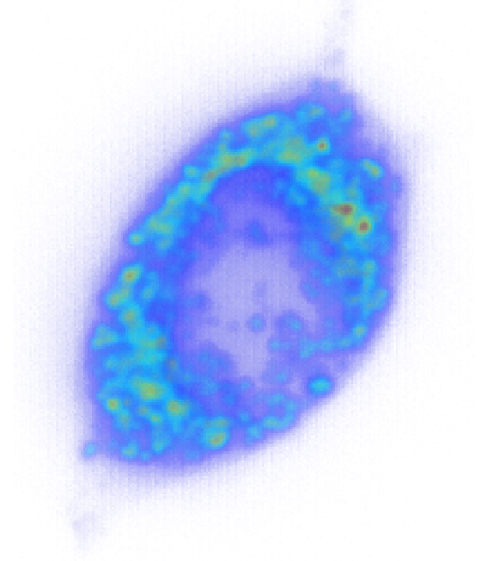
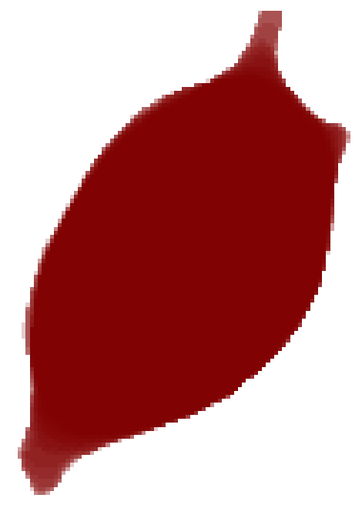
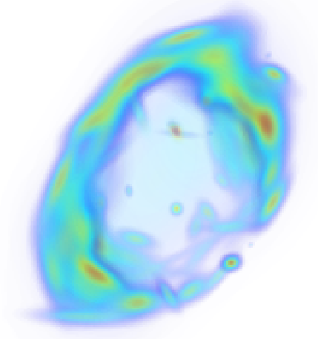

Image To Parameterization
Images
Parameterizations
X₁
p₁
Represent cell morphology in a compact set of parameters
We also desire an invertible function such that we can recover the original image
x_{i}
p_{i,1}
p_{i,2}
p_{i,3}
[ , , ]
cell
nucleus
protein pattern
f(x_{i}) = p_{i} ⟺ g(p_{i}) = x_{i}, i.,e.
p₁
x₁

Slide 6
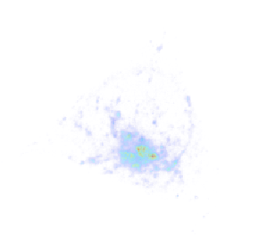
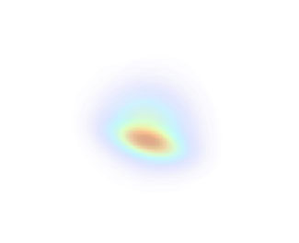
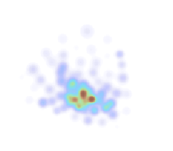
Image parameterization is lossy
LAMP2 Protein Pattern
Full covariance matrix
Gaussian fit
Spherical covariance matrix
Gaussian fit
GMM parameters
Represent the mixture from parameters
Image parameterizations vs number of parameters
Becomes Likelihood Maximization problem if K is known
Notes:
----- Meeting Notes (4/20/15 14:19) -----
Compact parameterizaton
Can be lossy
add gmm parameters to f(x) = p_i line
or pick k based on aic or bic

Slide 7
Shape Space Modeling Pipeline
a.
b.
0.85
0.63
0.74
0.90
d.
c.
MDS

Slide 8
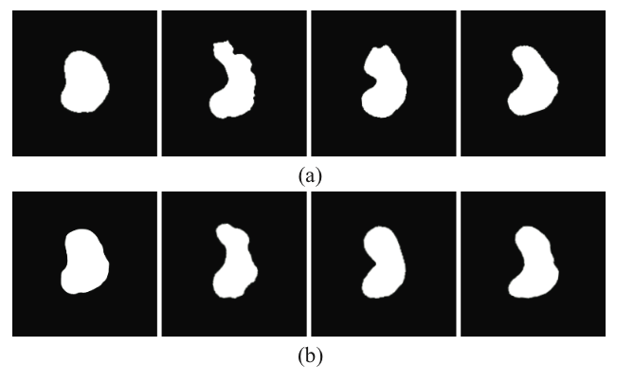
Image parameterization is lossy (contd.)
x₁
x₂
x₃
x₄
g(p₁)
g(p₂)
g(p₃)
g(p₄)
Where
Fig 2 from T. Peng et al, “Instance-based generative biological shape modeling” 2009.
Notes:
----- Meeting Notes (4/20/15 14:19) -----
By whatever criterion you choose the model, it may be imperfect

Slide 9

Multidimensional Scaling
= measured distance between shapes i, j
= Euclidian embeddings for all shapes
= Euclidean distance between embedding coordinates for shapes i, j
= Indicator for if D_{i,j} is observed

Slide 10
Shape space dimensionality vs Reconstruction
Reconstruction is dependent on the number of observed distances and the dimensionality of the embedding
blue = 1 dimensional embedding
red = “complete” embedding

Slide 11
Prediction of cell and nuclear dependency

Slide 12
The “goodness” of a cell parameterization
Many ways to do this
  Pixel-pixel Mean Squared
  Sørensen-Dice Coefficient for binary images and shapes
  Likelihood function…

Slide 13
Parameters to distribution
p₁
P(p_{i}|Ɵ)
…
p*
p_{n}
d({p₁,…,p_{n}}) = Ɵ
b(p|Ɵ) = p*

Slide 14
Parameters to distribution
p₁
P(p_{i}|Ɵ)
…
p*
p_{n}
d({p₁,…,p_{n}}) = Ɵ
b(p|Ɵ) = p*
“Straight forward” distribution learning and model selection
Some parameterization may overfit (i.e. point-mass)
Many models can not be learned via closed-form solutions
Predictive Maximum Likelihood i.e.
where n is the number of hold outs x^{n} is some hold-out subset and Ɵ^{n} is corresponding trained model

Slide 15
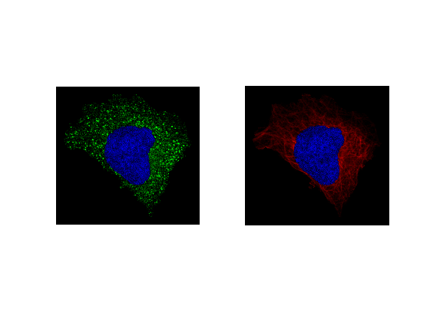
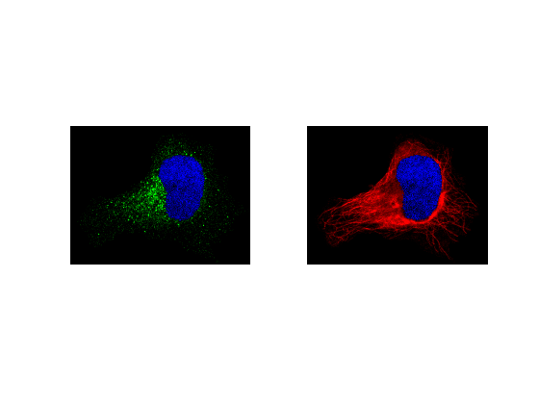
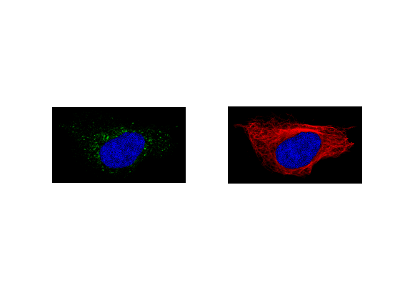
Distributions of object position
HIP1
ACBD5
SEC23B

Slide 16
Possible Models
Puncta are dependent on organelles, but independent of each other
  Poisson process
Puncta are dependent on organelles and each other
  Fiskel point process

Slide 17
Five-fold cross validation to choose the best model
Model with no puncta-puncta spatial interaction indicates greater likelihood!

Slide 18
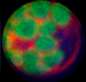
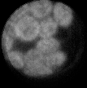
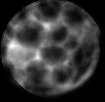
Toward Spatial Network Models
Colocalization is a complex network with interdependencies
Simplify it by use one-direction
dependencies (network -> DAG)
d_{nuc}
d_{cell}
a)
b)
c)
p_{prot}
i_{prot}
d_{prot}
d_{prot}
s_{prot}
A spatial network exhibiting negative colocalization
n_{prot}
Protein N
A diagram of a simplified spatial interaction network
Notes:
Fig 1. Representative image of segmented Arabidopsis plant protoplast. a) False colored image with green indicating auto fluorescent chloroplast channel and red indicating endoplasmic reticulum. b) Auto fluorescent chloroplast channel. c) ER channel. Notice the high degree of negative colocalization.
Fig 2. DAG of spatial interaction network, N is the number of protein patterns

Slide 19
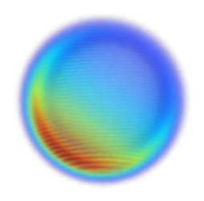
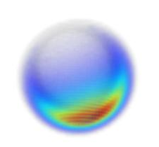
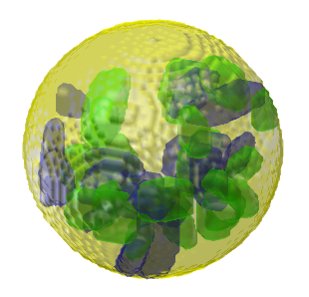
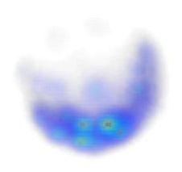
Pattern Modeling contd.
Generative Models
  Add parameters to account for spatial dependency of arbitrary numbers of protein patterns
P(Chloroplast | Cell)
P( ER | Cell)
3D rendering of a protoplast
P(Chloroplast | Cell)
P(ER | Cell, Chloroplast)

Slide 20
Big Picture…
Want most precise cell parameterization
f(x) = p, g(p) = x
Best-generalizing distribution
d({p₁,…,p_{n}}) = Ɵ
Images
Parameterizations
X₁
p₁
Sampled
Parameterizations
Synthesized
Images
X₂
p₂
p₁*
x₁*
P(p_{i}|Ɵ)
X₃
p₃
p₂*
x₂*
X₄
p₄
…
…
p_{m}*
x_{m}*
…
…
Cell Morphology
Distribution
X_{n}
p_{n}
f(x) = p
d({p₁,…,p_{n}}) = Ɵ
b(Ɵ) = p*
g(p) = x

Slide 21
Master Modeling function
How to build a master model-selection model
  g(p_{i}) with least error between x_{i} and g(p_{i})
d({p₁,…,p_{n}}) = Ɵ with greatest likelihood
Even if err_{tot} is some sort of proabilistic model, it is not clear how to balance err_{tot} and likelihood of the model
ESPECIALLY BECAUSE G(X) DRASTICTLY CHANGES VALUES OF Ɵ
Notes:
Spatial relationship model

