Slide 1
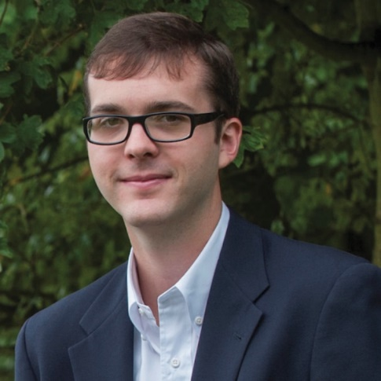
M
M
BioS
Training & Dissemination
Co-Leaders
Joseph C Ayoob, PhD
Associate Professor
Comp & Systems Biology
School of Medicine, Pitt
Phillip Compeau, PhD
Assistant Professor
Computational Biology
Carnegie Mellon University
Alexander Ropelewski
Director, Biomedical Applications
Pittsburgh Supercomputing
Center

Slide 2
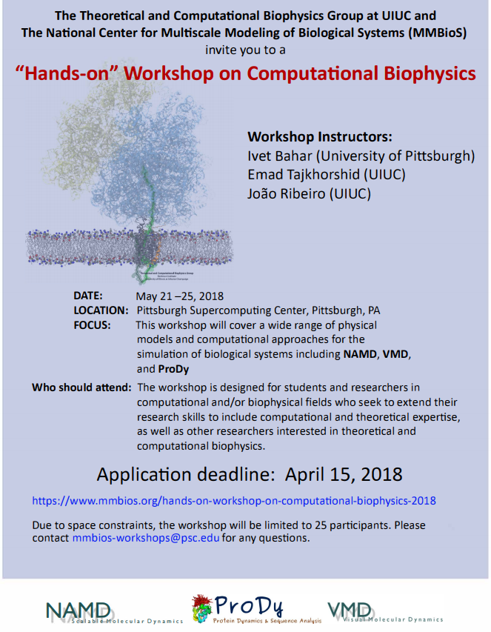
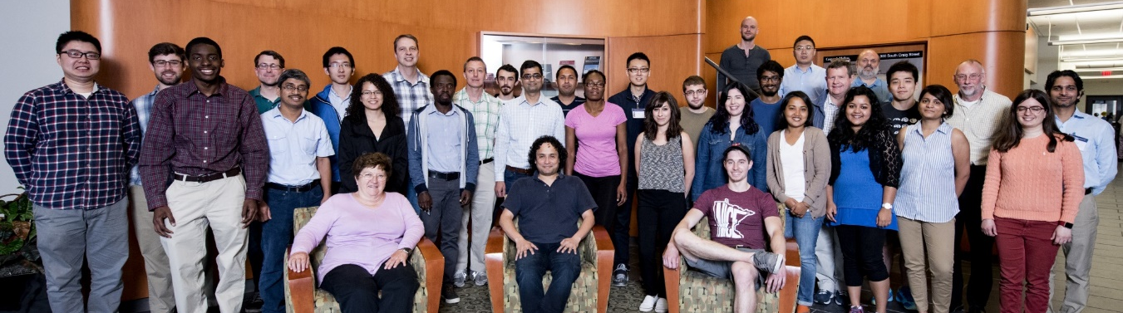
Training & Dissemination
M
M
BioS
Hands-on Computational
Biophysics Workshop
Joint between TR&D1 (Bahar) and Theoretical and Computational Biophysics Group at UIUC (Macromolecular Modeling and Bioinformatics BTRR; Schulten)
Software Featured: ProDy, NAMD, VMD, iGNM, and ANM
Five-day workshop
Offered Annually (6 times, ~25/workshop)

Slide 3
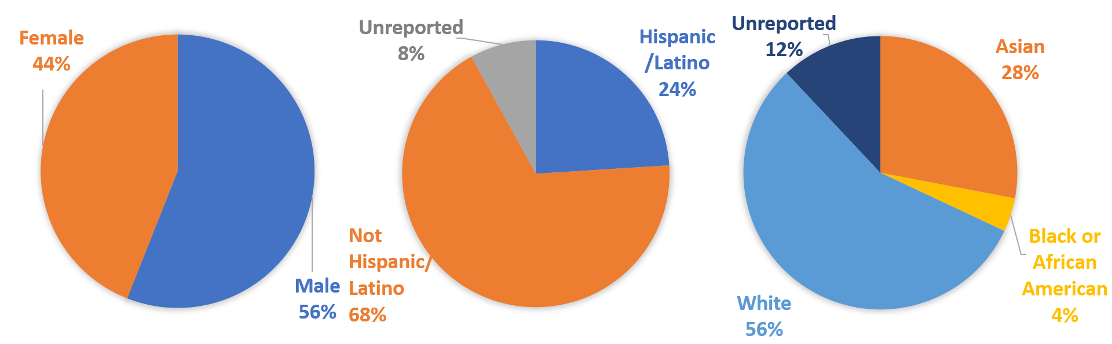
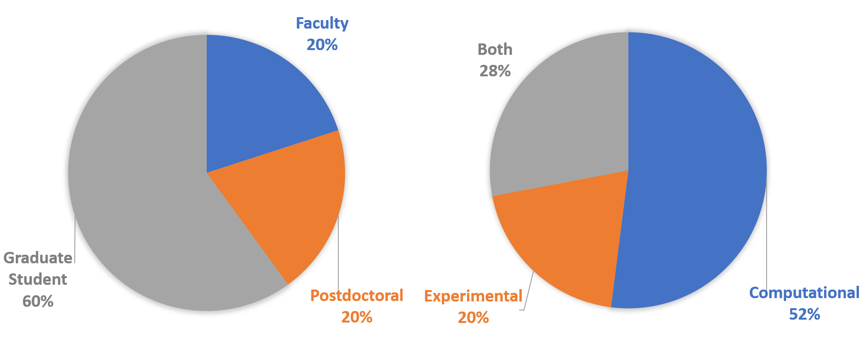
Training & Dissemination
M
M
BioS
Hands-on Computational
Biophysics Workshop - 2018

Slide 4
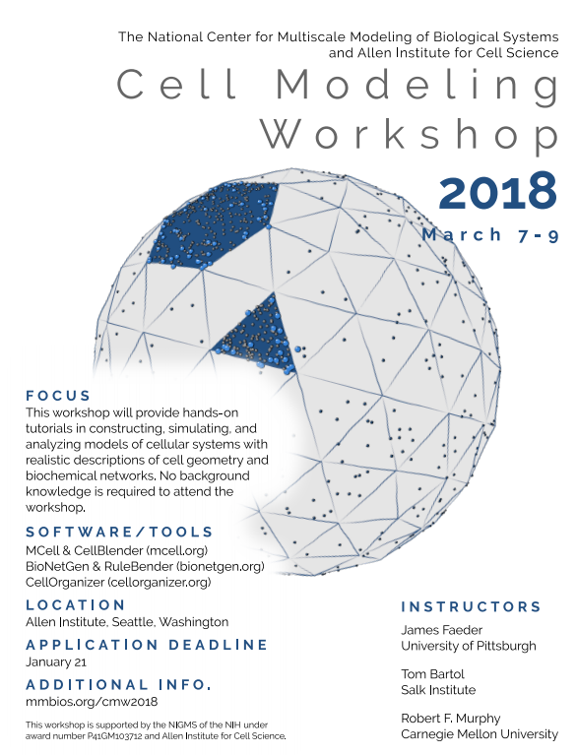

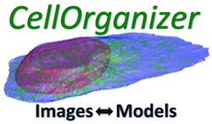
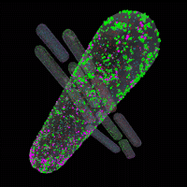

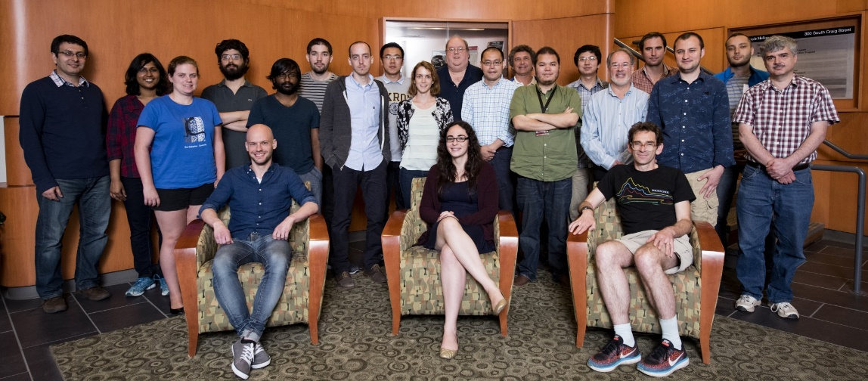
Cell Modeling Workshop
Training & Dissemination
M
M
BioS
Joint between TR&Ds 2, 3, and 4
Software Featured: MCell, CellBlender, BioNetGen, CellOrganizer
Three-day workshops
Offered Annually (6 times, ~20/workshop)
2018 held at Allen Institute for Cell Science
“I have attended two workshops on cell modeling and MCell in Pittsburgh and found them very well organized and extremely useful.”

Slide 5
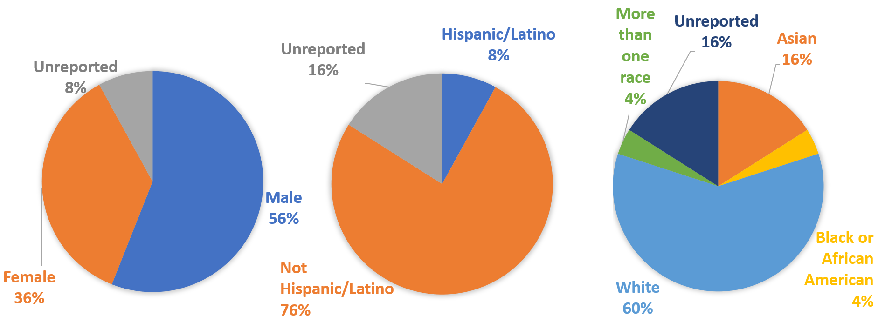
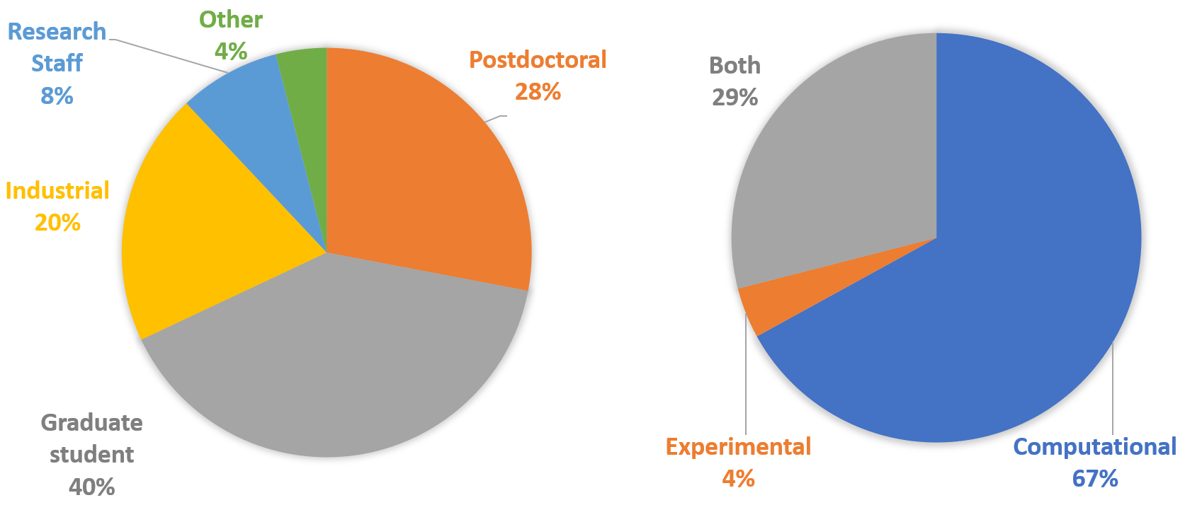
Cell Modeling Workshop - 2018
Training & Dissemination
M
M
BioS

Slide 6
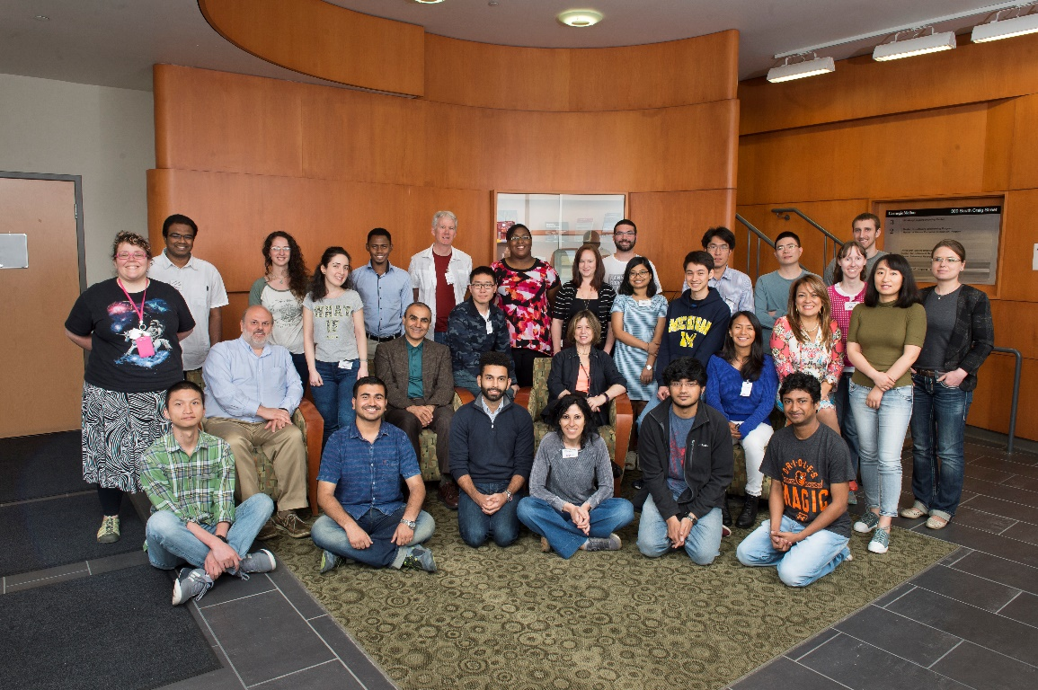
2019 Preliminary Workshop Plan
M
M
BioS
Hands-On Workshop in Computational Biophysics
  With Tajkhorshid P41
Cell Modeling Workshop
  Potentially in San Diego
Modeling Workshop
  With Another BRTP

Slide 7

TECBio REU Internship
Training & Dissemination
M
M
BioS
Training and Experimentation in Computational Biology
Research Experiences for Undergraduates
- 10 weeks; 12 students
- 320 applications/year
- Diverse – racially/ethnically and academically
- NSF (DBI-1659611) + Pitt funded (2 spots)
- PI: Ayoob
>2 undergraduate students each summer to work w/MMBioS Investigators
- 17 trainees over 6 summers

Slide 8
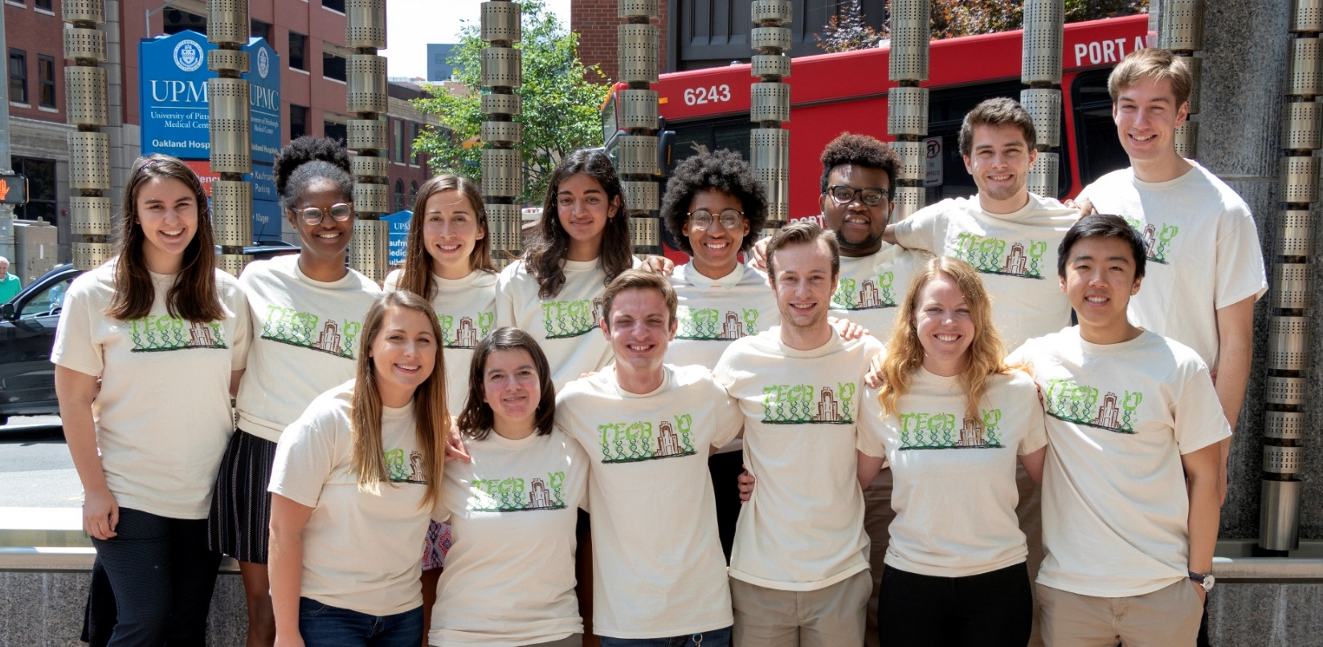
TECBio REU Internship
Training & Dissemination
M
M
BioS
Jenea Adams
Biology
University of Dayton
mentored by
Ivet Bahar
TR&D1
Caleb Reagor
Molecular Biology & Applied Math
Lipscomb University
mentored by
Jim Faeder
TR&D3

Slide 9
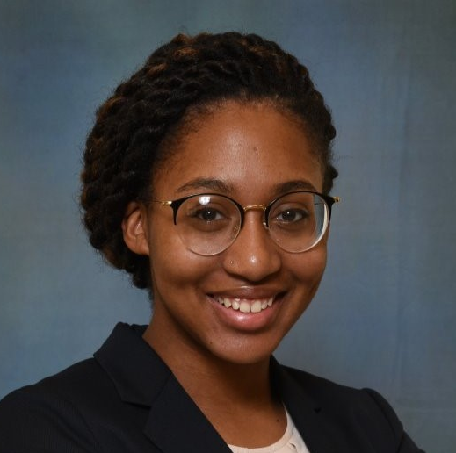
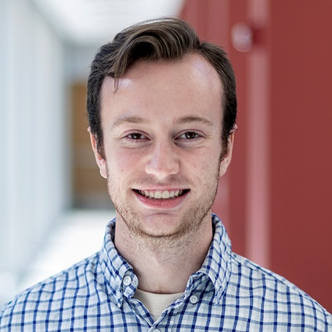
TECBio REU Internship Success Stories!
Training & Dissemination
M
M
BioS
Jenea Adams (Ivet Bahar, TR&D1)
“The role of sensors/effectors in protein-protein interactions”
- Selected participant for the Annual REU Symposium
Arlington, VA (October 2018)
- Abstract accepted at Annual Biomedical Research Conference for
Minority Students (ABRCMS), Indianapolis, IN (November 2018)
Caleb Reagor (Jim Faeder, TR&D3)
“Modeling information transmission in G protein-coupled
receptor signaling”
- Work selected as plenary presentation at the
Duquesne Annual Research Symposium

Slide 10
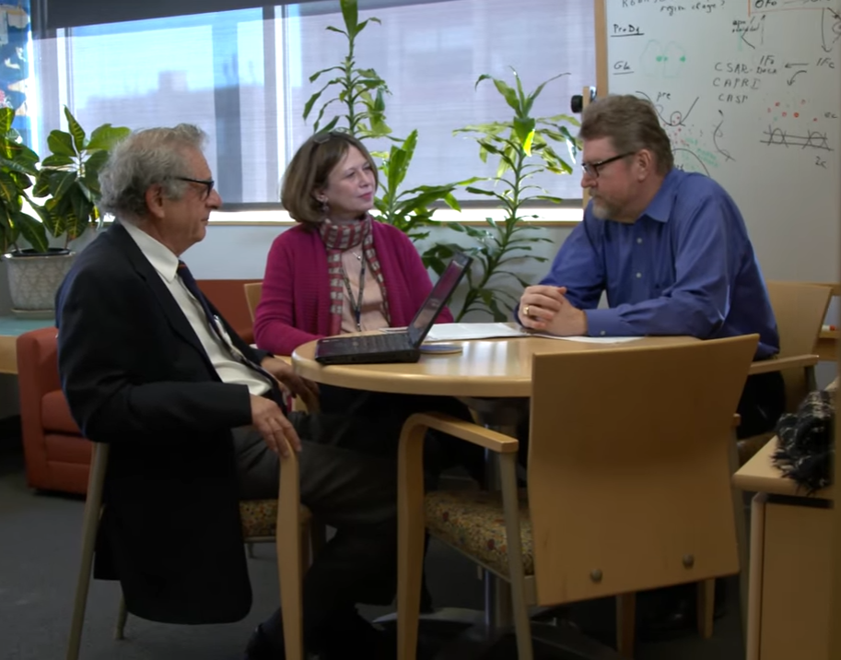
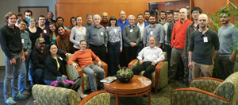
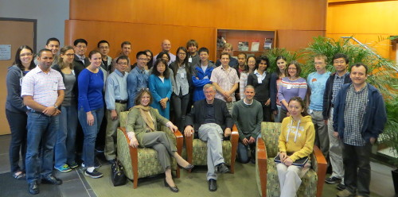
MMBioS Visitor Program
Training & Dissemination
M
M
BioS
Engage external scientific community
Establish and foster new collaborations over ~3 weeks
Dr. Mustafa Tekpinar (Bahar) → C&SP 23 (Kuriyan)
Andrey Popov (Faeder) → C&SP 31 (Sykulev)
Visitor Program
MMBioS Workshops
Your seat here!

Slide 11
Training & Dissemination
M
M
BioS
Multiscale Modeling of Biological Systems Course (MMBS)
Central Motivation for Each Key Software Resource
“What is a compelling biological task that can be performed with this software and can teach a wide audience a fundamental concept in modeling?”
User Engagement Level
Dedicated
Hands-on
Casual

Slide 12
Training & Dissemination
M
M
BioS
Building Synergies for MMBS Course
Offline Educational Programs
TECBio REU
TR&D1
Pre-College program
MMBS
Course
Workshops
TR&D2
TR&D3
Online Educational Programs
MOOC Providers
TR&D4
MMBioS Website

Slide 13
Training & Dissemination
M
M
BioS
Building Synergies for MMBS Course
Each TR&D inspires creation of (at least) one lengthy module, helping us achieve modeling at multiple scales.
Offline Educational Programs
TECBio REU
TR&D1
Pre-College program
MMBS
Course
Workshops
TR&D2
TR&D3
Online Educational Programs
MOOC Providers
TR&D4
MMBioS Website

Slide 14
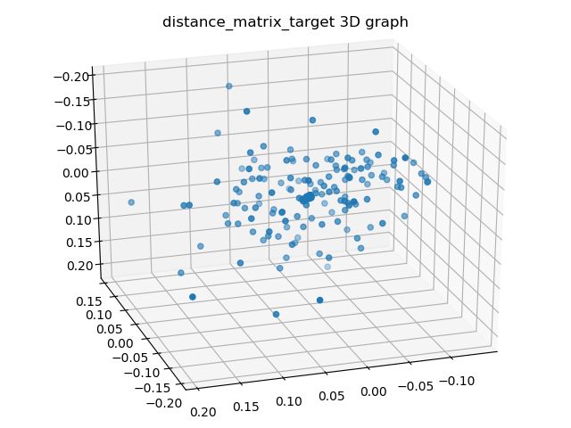
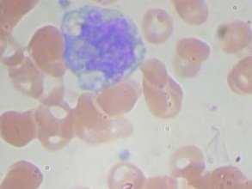
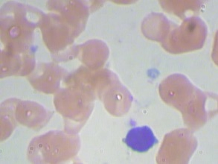


Training & Dissemination
M
M
BioS
Example: Segmentation/Classification of WBC Families with CellOrganizer (TR&D 4)
Ulani Qi
Wendy Velasquez
Ebanks

Slide 15
Training & Dissemination
M
M
BioS
Building Synergies for the MMBS Course
We plan to host some version of MMBS both on the MMBioS website (using PSC infrastructure) as well as part of third-party providers.
Offline Educational Programs
TECBio REU
TR&D1
Pre-College program
MMBS
Course
Workshops
TR&D2
TR&D3
Online Educational Programs
MOOC Providers
TR&D4
MMBioS Website

Slide 16
Training & Dissemination
M
M
BioS
Building Synergies for the MMBS Course
We also want to plug modules into existing offline efforts. For example, for high-flying TECBio REU students and as prerequisite for workshop attendance.
Offline Educational Programs
TECBio REU
TR&D1
Pre-College program
MMBS
Course
Workshops
TR&D2
TR&D3
Online Educational Programs
MOOC Providers
TR&D4
MMBioS Website

Slide 17
Pre-College Program in Computational Biology (summer 2019)
Three week high school program organized by Carnegie Mellon (20-25 students).
Intensive, complementary dry/wet lab experience.
Special focus on Pittsburgh-area and underrepresented students.
Integrating MMBS Software modules into analysis components.

