Slide 1
TR&D2 Cell Modeling
TR&D2 (Sejnowski)
Leader: Terry Sejnowski, Salk Institute
Team:
Tom Bartol (Salk)
Bob Kuczewski (Salk)
Oliver Ernst (Salk)
Mariam Ordyan (Salk)
Sophia Hirakis (Salk)
Mohammad Samavat (Salk)
Art Wetzel (PSC)
Greg Hood (PSC)

Slide 3
7 Big Questions
TR&D2 (Sejnowski)
1) What is the spatiotemporal organization of proteins in the PSD
2) What is the spatiotemporal organization of AMPARs in spines and dendrites
3) How do the pre- and post- synaptic structures co-organize to form a functioning synapse
4) What are the structure/function relationships among multiple spines on a dendrite
5) How does this change during synaptic plasticity
6) What is the energy (i.e. ATP) budget of synaptic plasticity
7) How is energy demand coupled to energy supply in spines and dendrites
A central theme here: Dendritic spines are crowded and dynamic biochemical environments with a high-degree of spatial organization.

Slide 4
Our Aims
Specific Aim 1. Expand Simulation Capabilities for MCell.
Subaim 1.1: Spatially structured, multi-state multi-component molecules.
Subaim 1.2: State-dependent dynamic geometries
Subaim 1.3: Parallel MCell
Specific Aim 2. Create a Geometry Preparation Pipeline for MCell/CellBlender
Subaim 2.1: Improved workflow for high quality alignment of 3DEM datasets
Subaim 2.2: Improved workflow for transforming segmented structures into computational quality meshes.
Specific Aim 3. Expand interfaces for MCell and CellBlender.
Subaim 3.1: libMCell API for advanced simulation event-scheduler/event-handler.
Subaim 3.2: libMCell API for model building from C and Python.
Subaim 3.3: Interface to Web/Cloud computing resources for MCell/CellBlender.

Slide 5
TR&D2 (Sejnowski)
Our Approach: Nurture collaborative DBP and CS&P relationships to perform research and develop the new technologies required to tackle the Big Questions
We have been able to capitalize on our existing collaborations:
Mary Kennedy (DBP2) (Caltech) (Biochemical interactions in PSD)
Kristen Harris (DBP7, UT Austin) (Synaptic structure/function)
Eric Mjolsness (UC Irvine) (Machine learning for Multiscale methods)
And begin new relationships:
Daniel Choquet and Eric Hosy (Univ. Bordeaux) (AMPAR trafficking)
Alexander Skupin (Univ. Luxembourg) (Mitochondrion struct/func)
Padmini Rangamani (UC San Diego) (Energy budget of plasticity)

Slide 6
TR&D2 (Sejnowski)
To support these research projects we have expanded the capabilities of our flagship technology, MCell/CellBlender for creation, simulation, and visualization of realistic 3D models:
Subaim 1.1: Spatially structured macromolecular complexes
Rule-based version of MCell/CellBlender in close collaboration with Faeder Lab:
combines capabilities of MCell, BioNetGen, and NFSim
enables new models of macromolecular complex interactions within dendritic spines and PSD including synGAP, PSD95, AMPAR-TARPs, NMDAR, NLGs, NRXNs, Calmodulin, CaMKII, mGluRs and more (Kennedy, Hosy, Sejnowski CRCNS)
several manuscripts already published, in review, or in preparation.

Slide 7
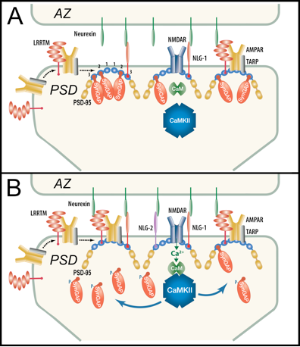
DBP2 - Competitive interactions among ligands of PDZ domains of PSD-95
DBP2 explores the hypothesis that during LTP phosphorylation of synGAP by CaMKII in the PSD reduces the affinity of synGAP for the PDZ domains of PSD-95. This shift in affinity reorganizes the PSD due to increased association of AMPAR-TARP, LRRTMs, and neuroligins with the PDZ domains of PSD-95. The presynaptic AZ is also affected due to interactions of LRRTMS and neuroligins with neurexins in the AZ.

Slide 8
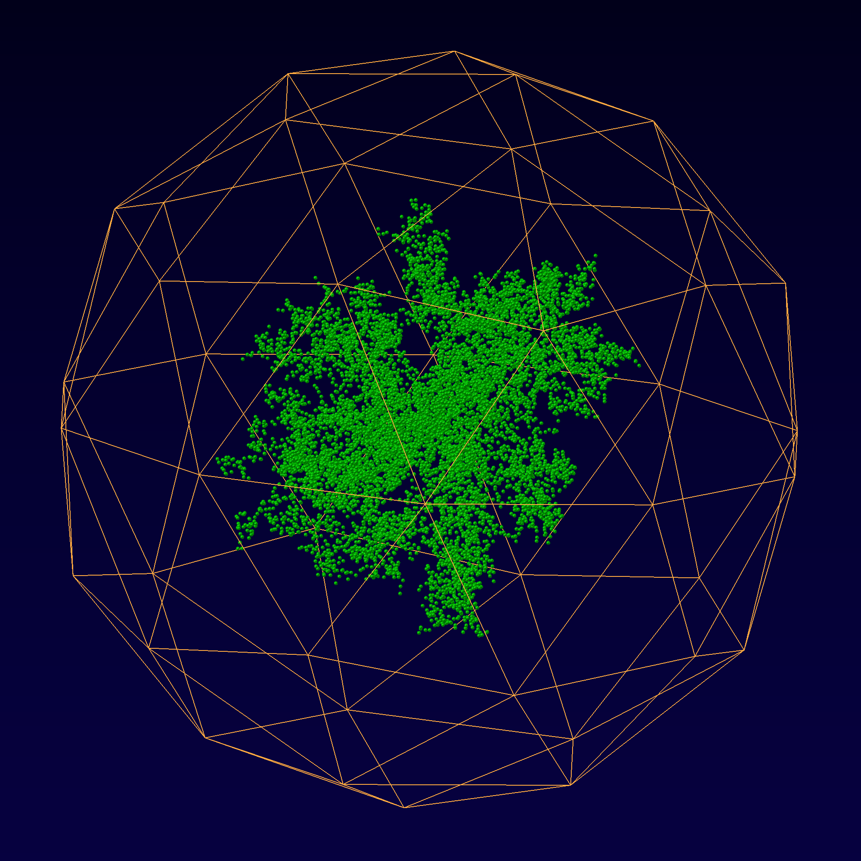
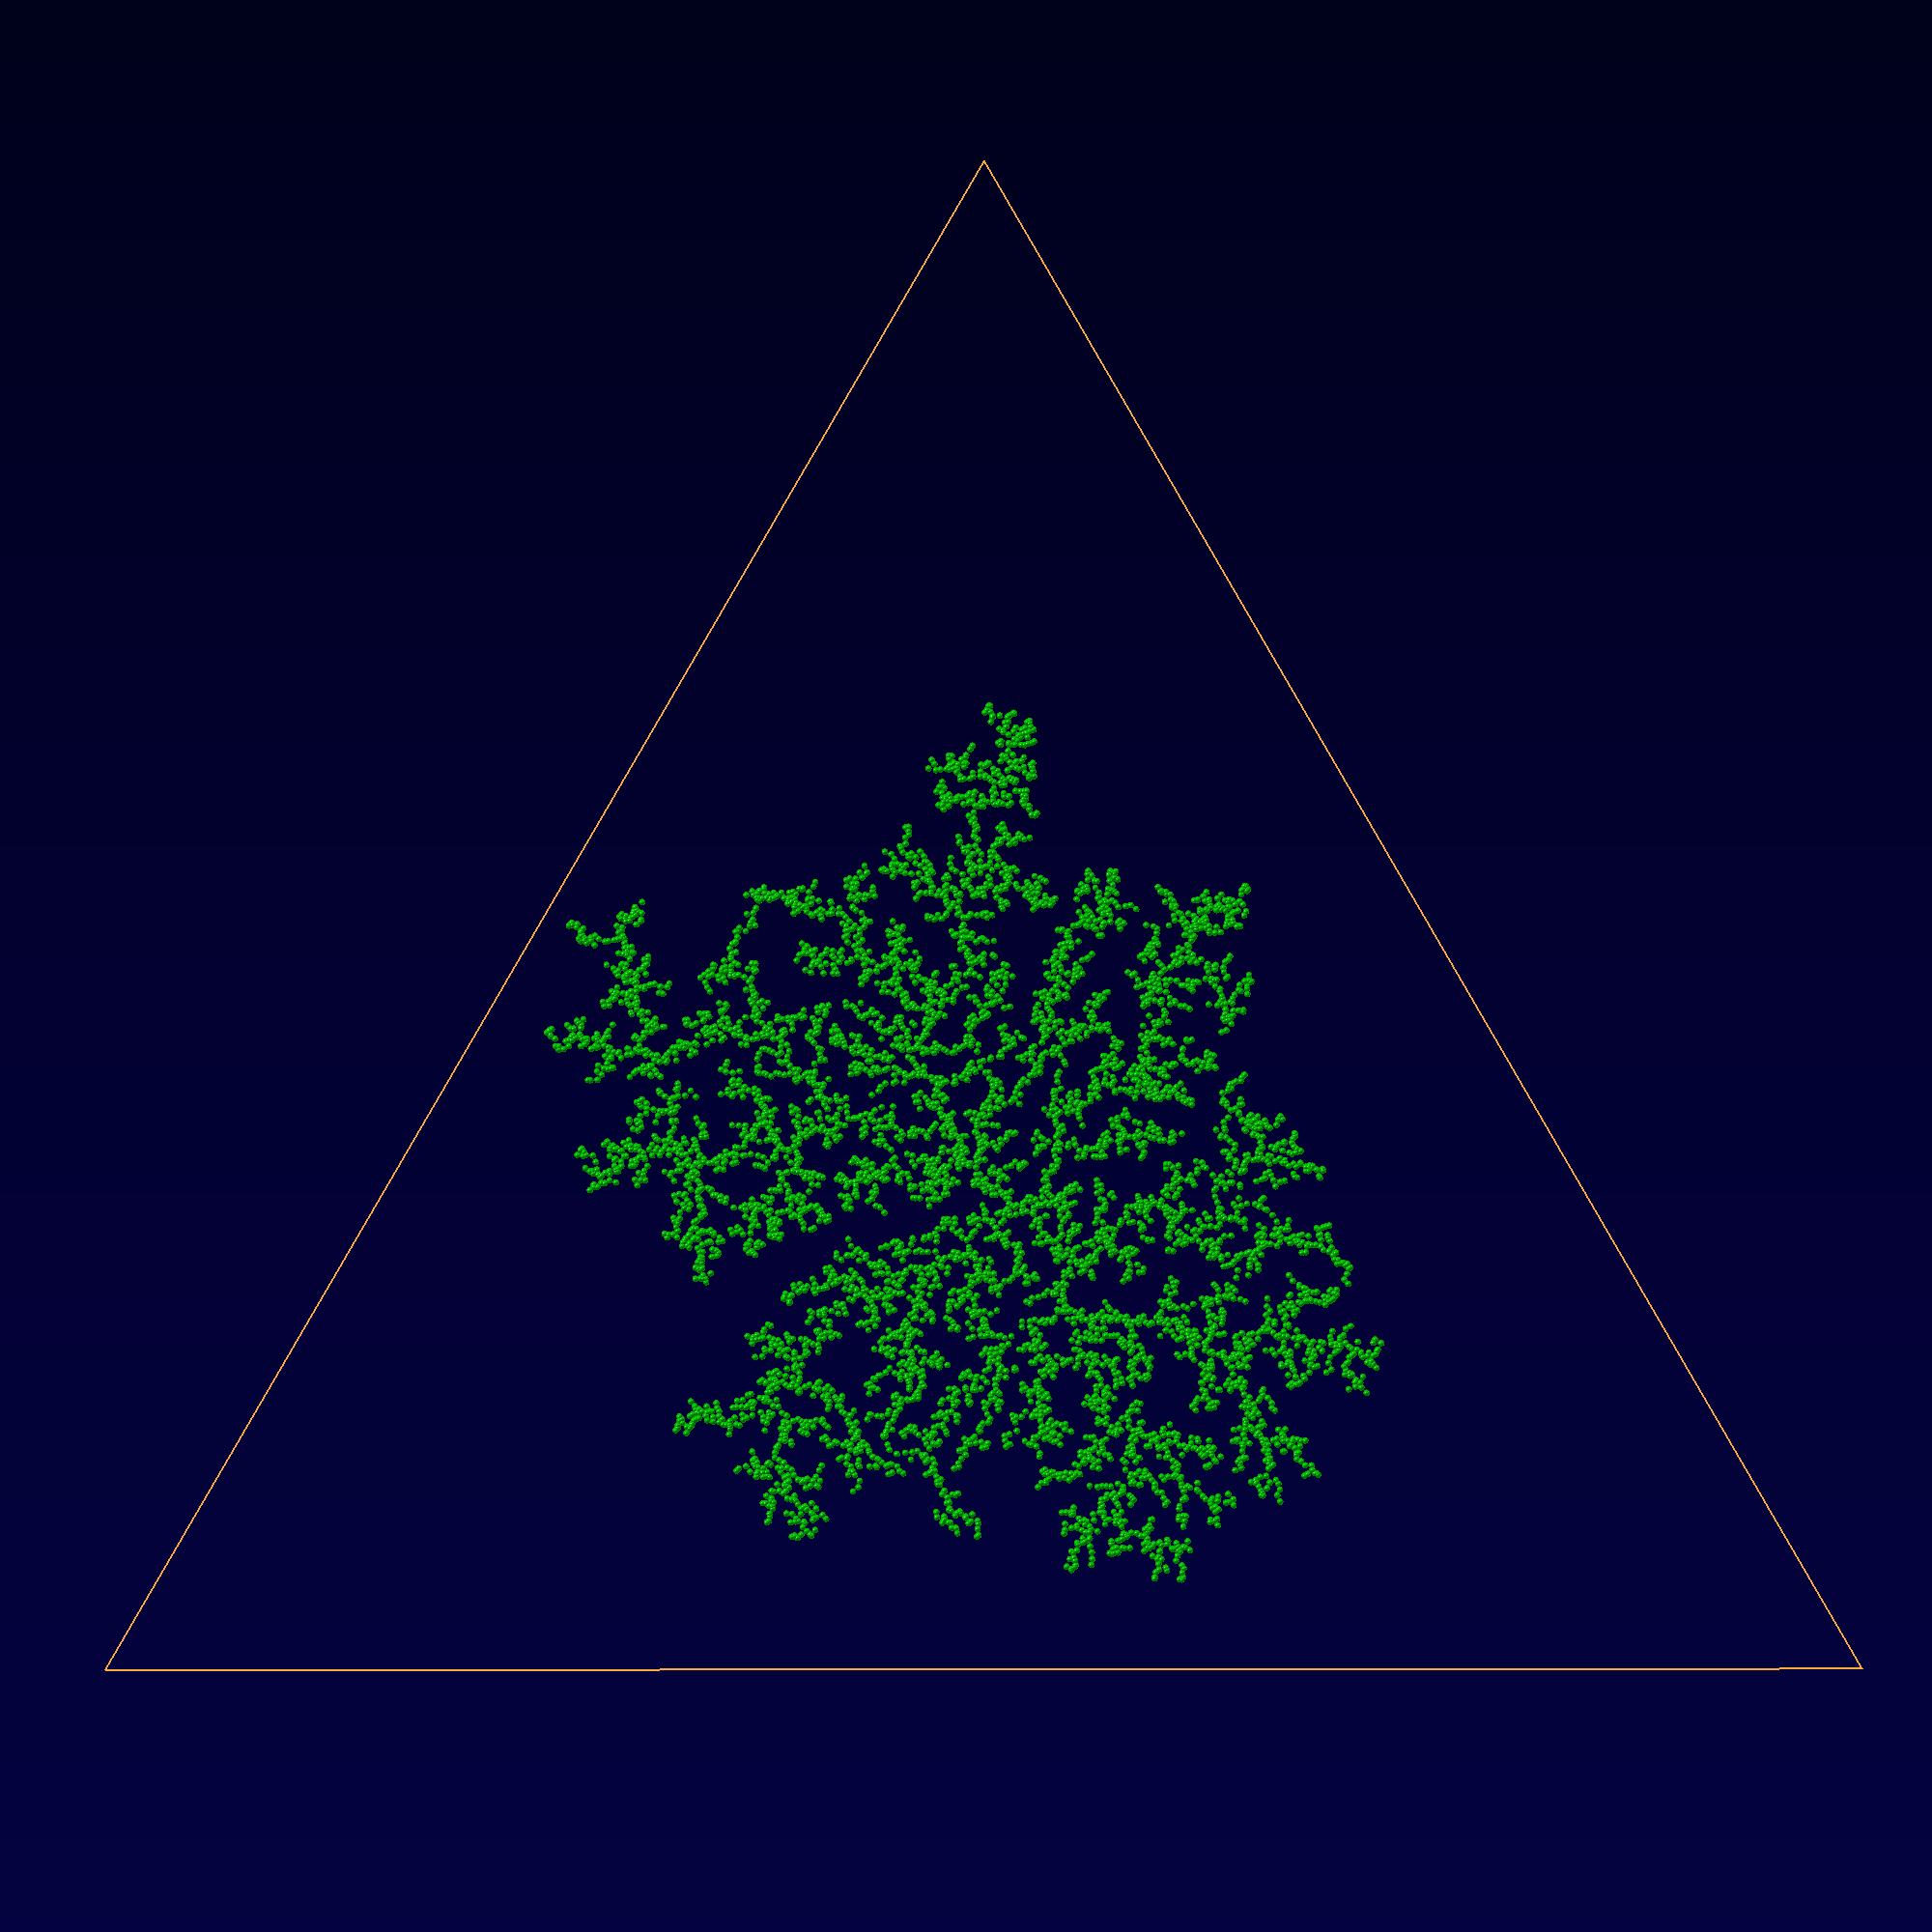
Emergence of Large-Scale Fractal Filigree Spatial Structure From Unordered Diffusion-Limited Aggregation
TR&D2 (Sejnowski)
A + B -> B + B
3D
2D

Slide 9
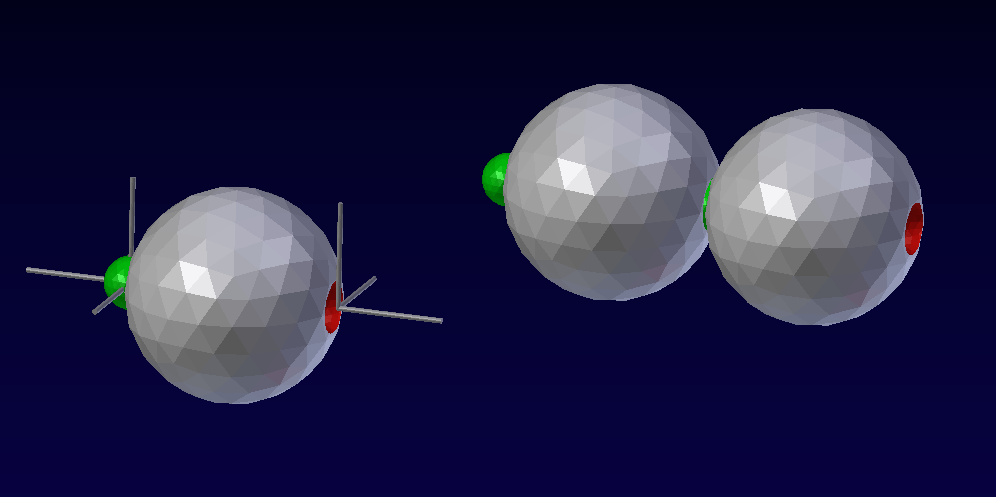
Emergence of Large-Scale Ordered Spatial Structure
From Simple Local Assembly Rules
TR&D2 (Sejnowski)
Assembly by aligning and docking the binding site coordinates

Slide 10
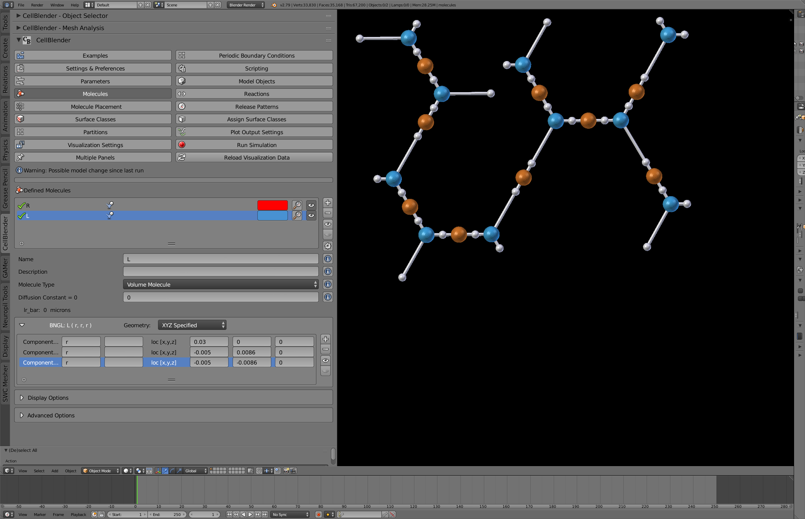
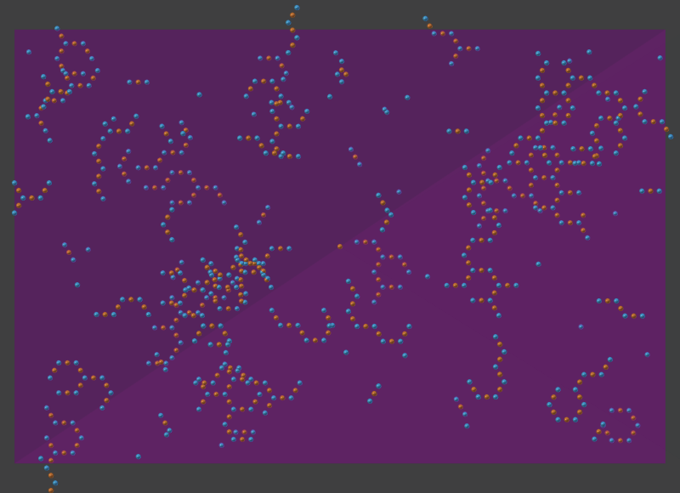
Define, Simulate, and Visualize Spatially Structured Complexes
TR&D2 (Sejnowski)

Slide 11
Challenges in simulation of Spatially Structured Complexes
TR&D2 (Sejnowski)
How to get coordinates of components (i.e. binding sites)?
from PDB?
How to handle diffusion of small complexes?
aggregation of macromolecule members/components?
How to do diffusion of large complexes?
tumbling?
How to do collision detection?
non-space-filling/non-crowding?
space-filling/crowding?
Other issues?

Slide 12
TR&D2 (Sejnowski)
Pre-post synaptic alignment through neuroligin-1 tunes synaptic transmission efficiency.
Haas KT, Compans B, Letellier M, Bartol TM, Grillo-Bosch D, Sejnowski TJ, Sainlos M, Choquet D, Thoumine O, Hosy E
Elife. 2018 Jul 25;7. pii: e31755. doi: 10.7554/eLife.31755.
nGlu 2000

Slide 13
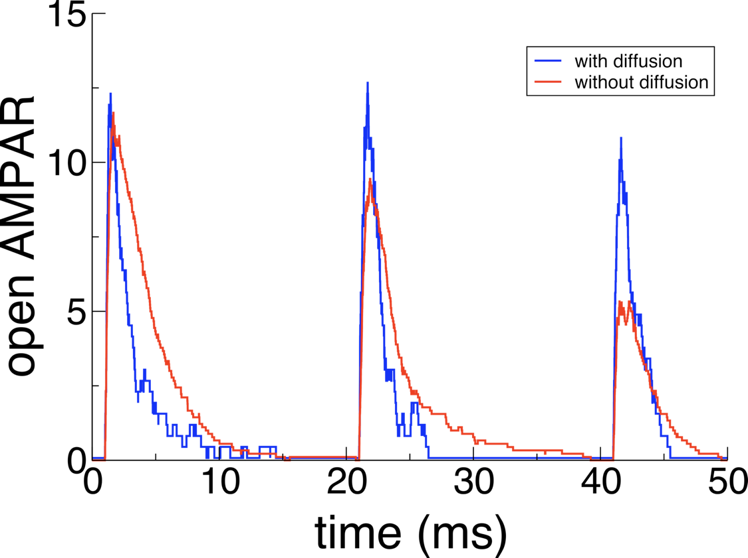
AMPAR Diffusion and Clustering Reduces AMPAR Desensitization During EPSCs
(previously shown experimentally by Constals et al., Neuron, 2015)

Slide 14
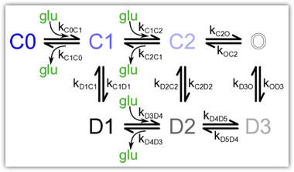
TR&D2 (Sejnowski)

Slide 15
TR&D2 (Sejnowski)

Slide 16
Specific Aim 2. Create a Geometry Preparation Pipeline for MCell/CellBlender
DBP7: Collaboration with Kristen Harris Lab
(NSF NeuroNex Technology Hub)
Scale-up throughput of 3DEM Pipeline
Integration of Neuropil Tools and SWiFT-IR
Co-hosted 3DEM Workshop at Austin in August
Co-organizing NeuroNex Workshop at SfN in November

Slide 17
TR&D2 (Sejnowski)
26 distinguishable sizes = 4.7 bits of information in synaptic weight

Slide 18
TR&D2 (Sejnowski)
2.8 bits
3.2 bits

Slide 19
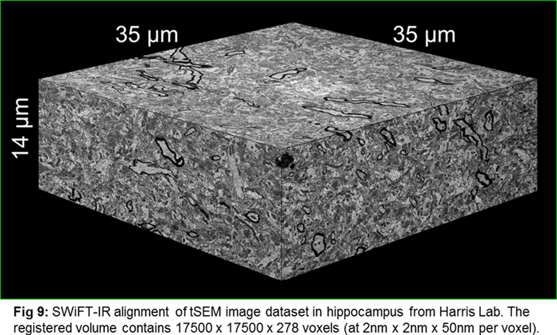
Subaim 2.1: Improved workflow for high quality alignment of 3DEM datasets Robust and User Friendly Interface for SWiFT-IR
TR&D2 (Sejnowski)
SWiFT-IR alignment of tSEM image dataset in hippocampus from Harris Lab.
The registered volume contains 17500 x 17500 x 278 voxels (2nm x 2nm x 50nm).

Slide 20
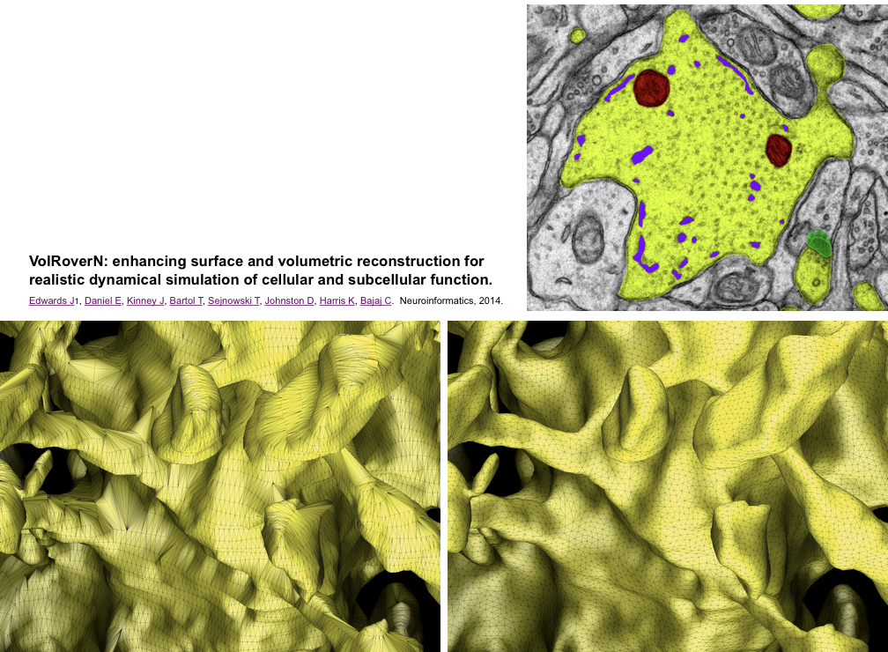
TR&D2 (Sejnowski)
Subaim 2.2: Improved workflow for transforming segmented structures into computational quality meshes.
Mesh Generation and Mesh Improvement
ForestTiler: Contours to Mesh Generator
Geometry Perserving Adaptive Mesher

Slide 21
Mitochondrion Reconstruction

Slide 23
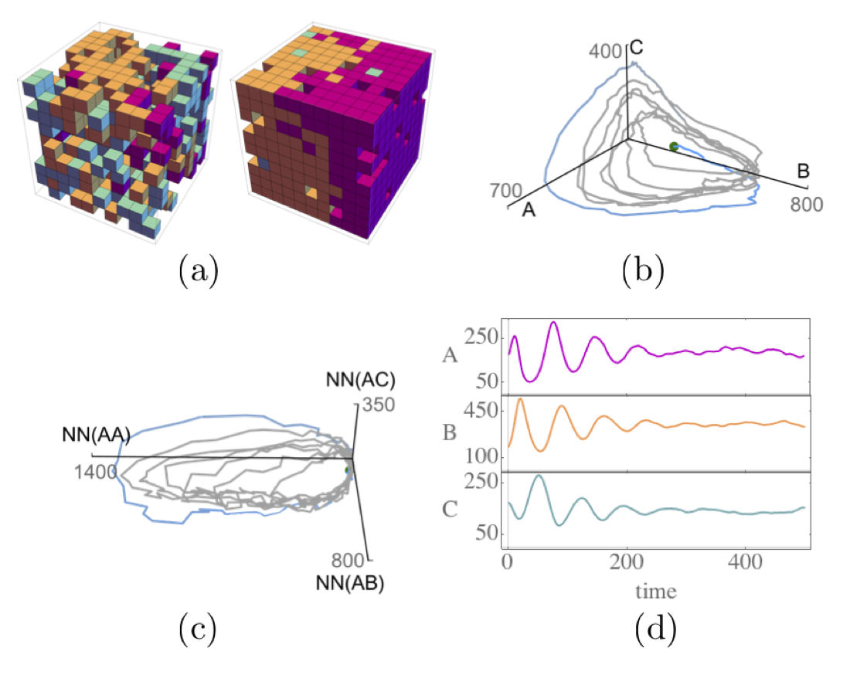
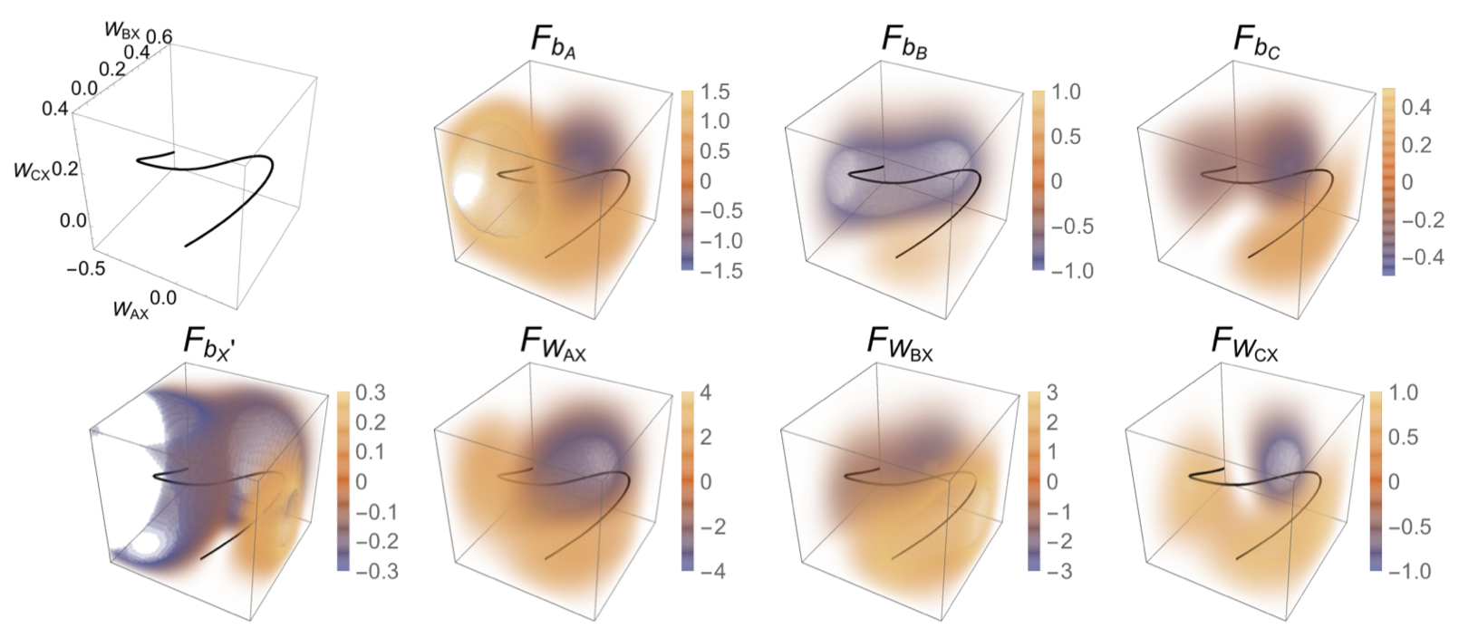
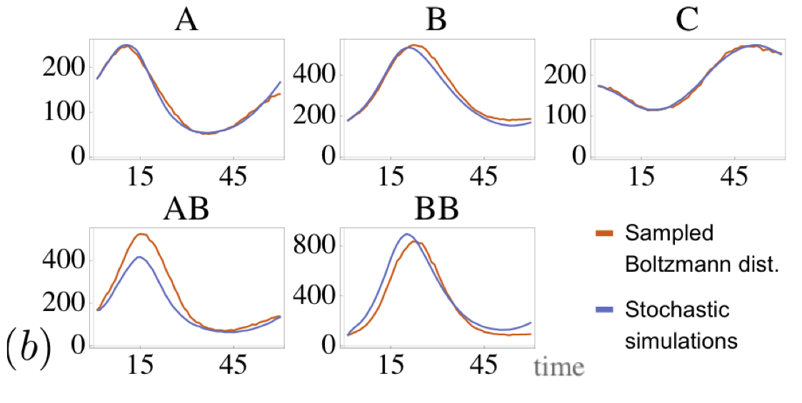

Slide 24
Future Goals
Moving forward, all new features await MCell-4
Asynchronous parallel event-driven multi-scale framework supporting independent interacting agents
Hiring new scientific programmer

