Slide 1

Organization and dynamics of AMPAR glutamate receptors
Ingo Greger
MRC Laboratory of Molecular Biology
Cambridge, UK

Slide 2
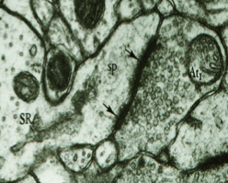
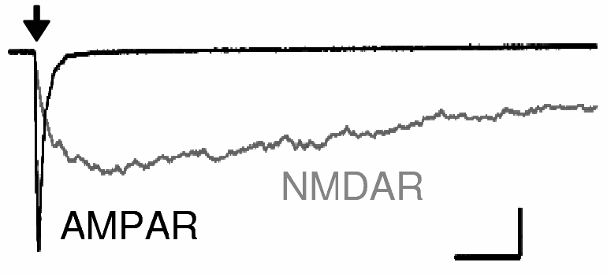
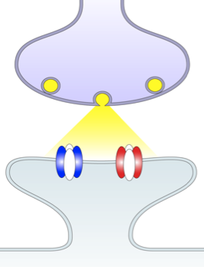
AMPA receptors initiate transmission at excitatory synapses
pre
L-Glu
post
pre
NMDAR
AMPAR
10 pA
10 ms
+
+
+
+
Spruston, J. Physiol. 1995
+
+
+
post

Slide 3
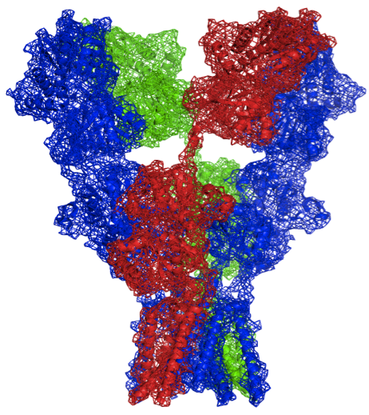
3-layered architecture of AMPA-Rs tetramers and assembly interfaces
N-terminal domain
(NTD)
Ligand-binding domain
(LBD)
out
ion channel
(TMD)
in
Distal
BD
Proximal AC
GluA1-4

Slide 4
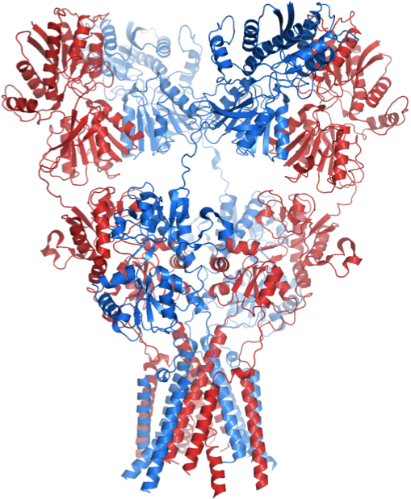
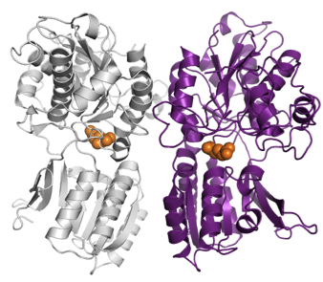
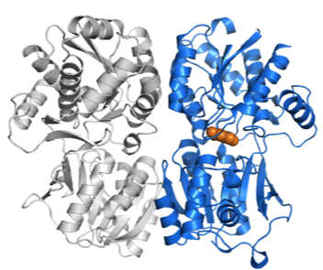
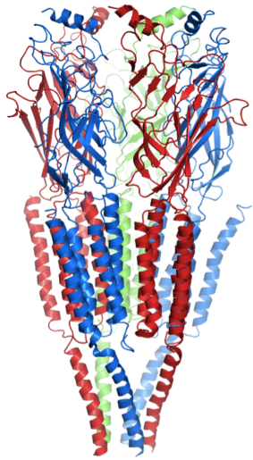
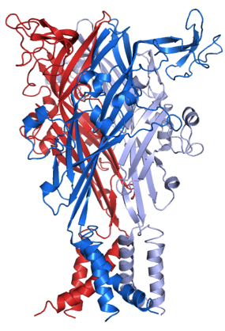
Modular organization of the iGluR extracellular region
mGluR
GABA_{B}
out
Sukumaran, Bahar/Greger et al., 2011. EMBO J. 30, 972.
Dutta, Greger/Bahar et al., 2012. Structure 20, 1838.
Krieger, Bahar, Greger, 2015. Biophys. J. 109, 1136.
in
Glutamate
(pdb 3kg2)
P2X
(pdb 4dw0)
Acetylcholine
(pdb 2bg9)

Slide 5
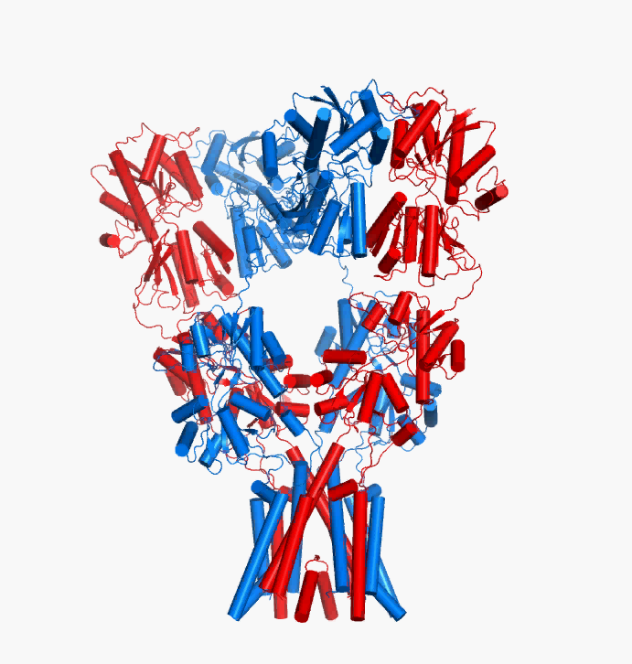
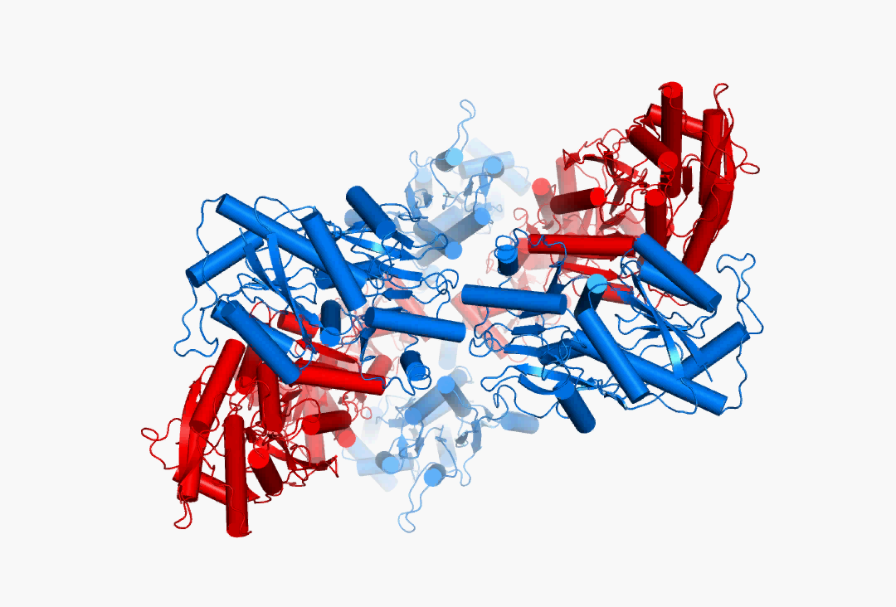
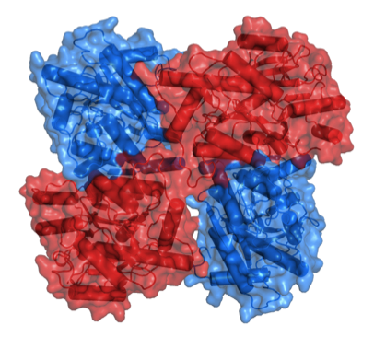
Alternative arrangement of the AMPAR NTD layer
simulation
Top views
crystal
3
2
Front view
2
3
Dutta, Greger/Bahar et al., 2015. Structure 23, 1692.
Notes:
Figure 2.

Slide 6
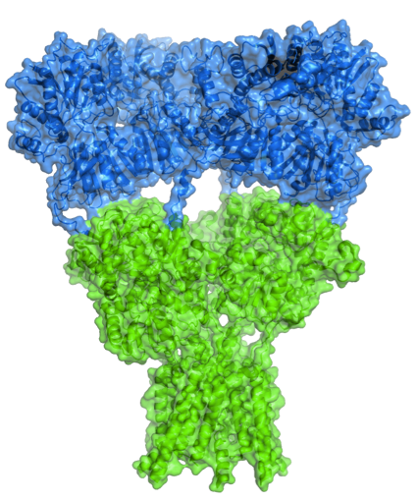
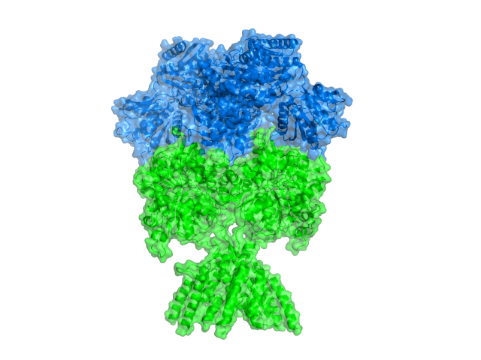
AMPA-R N-terminal domains are loosely connected
NMDA-R NTD-LBD form an ‘allosteric unit’
NMDA-R
AMPA-R
NTD
LBD
TMD
pdb 4pe5
pdb 3kg2

Slide 7
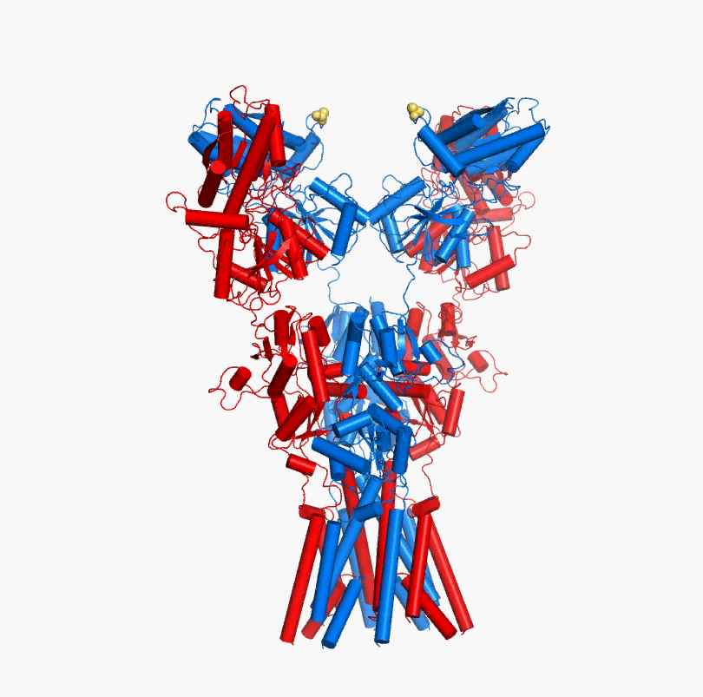
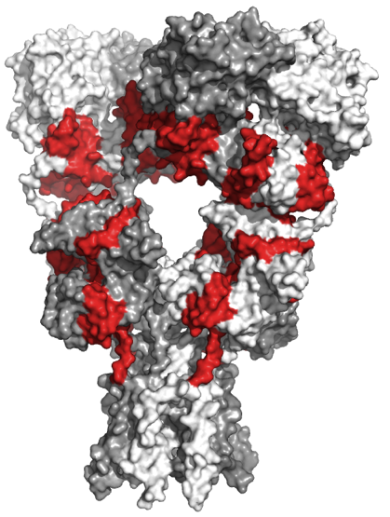
ANM mode 2 permits downward motion of the NTD dimers
NTD
LBD
TMD
TARP γ2 contacts
Cais et al. 2014 Cell Rep 9, 728.
Dutta, Greger/Bahar et al., 2015. Structure 23, 1692.

Slide 8
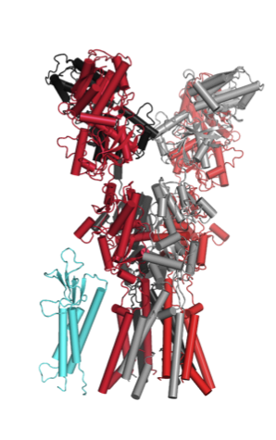
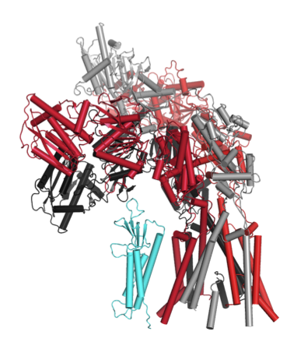
Dynamic rearrangements in the AMPAR ECR
^{- TARP}
^{+ TARP}
^{NTD}
^{LBD}
NTD
LBD
Mode 1
‘TARP’
TMD

Slide 9
Rearrangements may affect organization/stability/function of synaptic AMPARs
NTD
TARP
Constals et al., 2015. Neuron 85, 787.

Slide 10
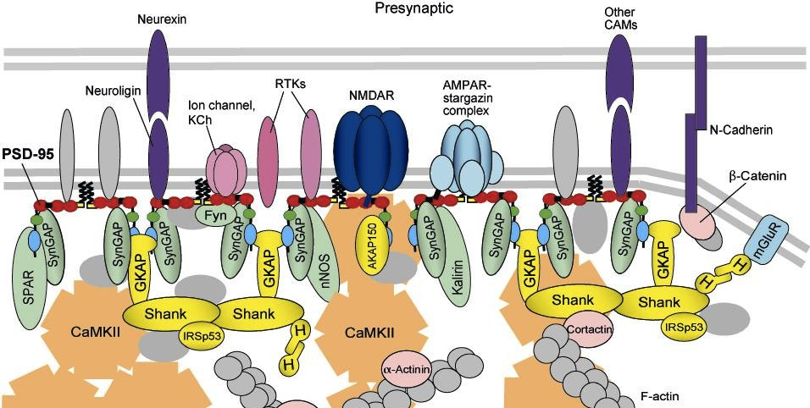
Function of the AMPA-R NTD at synapses
pre
post

Slide 11




Thanks to
Ondrej Cais Mark Farrant/Stuart Cull-Candy (UCL)
Bea Herguedas Karolina Krol, Tommy McGee
Javi Garcia-Nafria
James Krieger Ivet Bahar/Anindita Dutta/Ji Young Lee (Pittsburgh)
Madhav Sukumaran
Maxim Rossmann
Saher Shaikh

