Slide 1
DBP5 Functional Connectomics: Terascale Reconstructions of Cortical Circuits
September 17, 2015
R. Clay Reid, MD, PhD

Slide 2
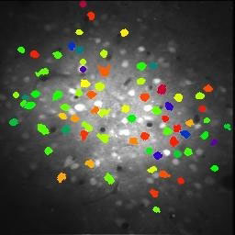
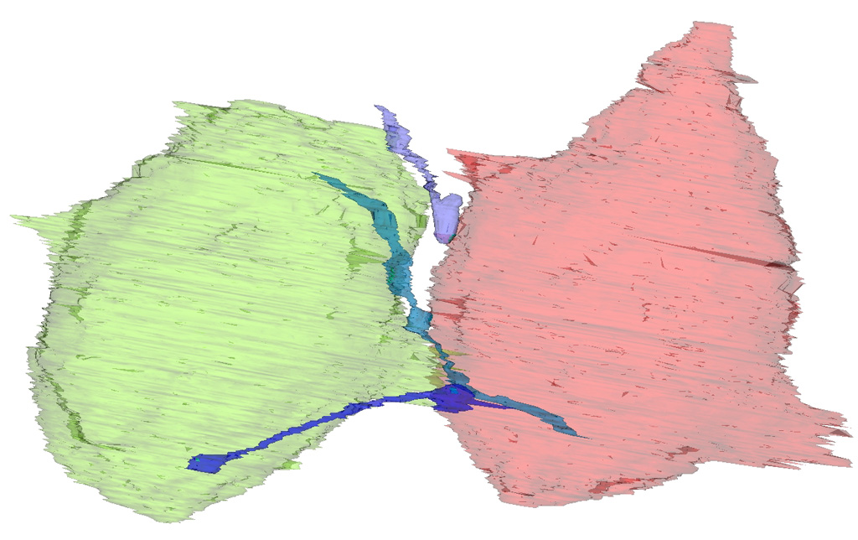
2p title
Functional connectomics, background
Bock, … Hood, Wetzel, Reid, 2011 Nature
Reid 2012 Neuron
Large-scale physiology Two-photon calcium imaging
in vivo
Physiology of every cell
Large-scale anatomy
Serial-section electron microscopy
Every axon, dendrite, and synapse

Slide 3
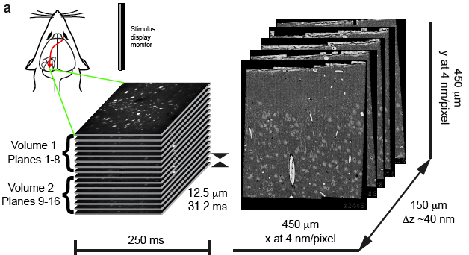
Functional connectomics 2nd project
2014: Hundreds of neurons, thousands of connections from EM data set
>10 Gpixels per section
~3800 sections → 150μm thick
~40 TB of aligned data
• EM volume: 450 x 450 x 150 μm
Lee, Reid Unpublished

Slide 4
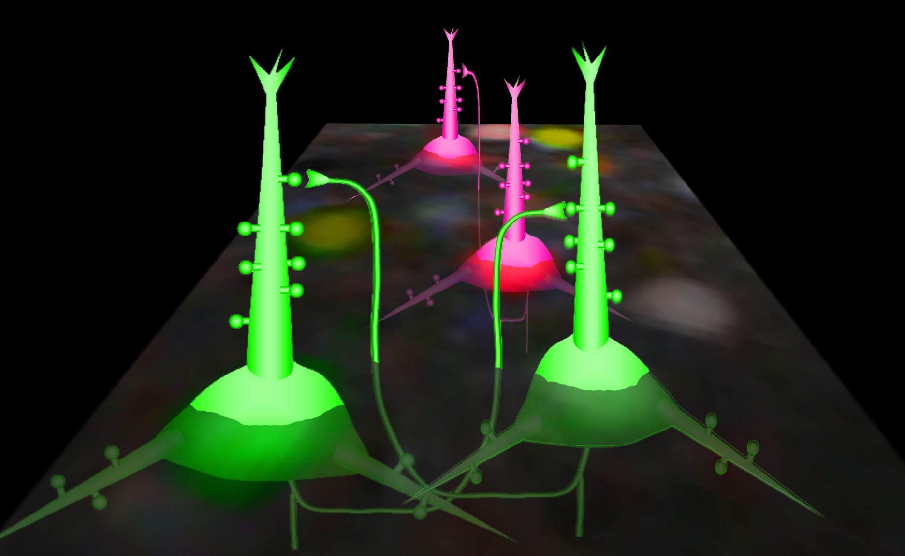
What do cells do?
Functional imaging
How are they wired?
3D electron microscopy
Every brain is different,
but the rules and motifs may be the same
Notes:
Make the EM figure rotate

Slide 5
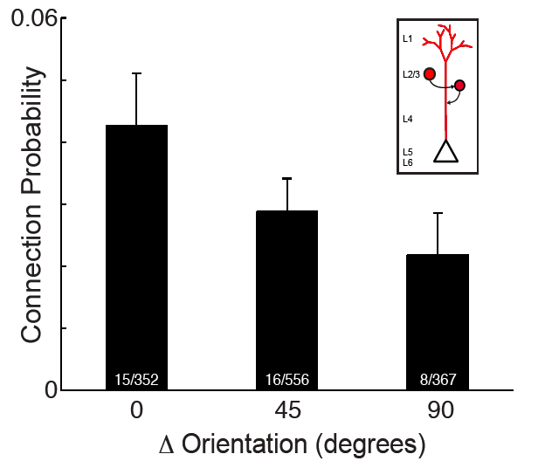
Functional properties predict connectivity
Neurons with similar preferred orientation are most likely to be connected!
Lee, Bonin et al
In review Nature

Slide 6
Functional connectomics
2011: 1000 EM sections. Tens of neurons, hundreds of connections
2015: ~4000 EM sections. Hundreds of neurons, thousands of connections
2017: ~20k sections. Thousands of neurons, ? Connections.
The grand experimental challenge of cortical connectomics: 1 mm³, a cortical module.
Stitching and aligning 1 PB of data, ~2.5 x 10⁸ images.

