Slide 1
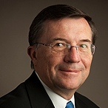
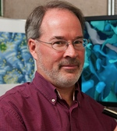
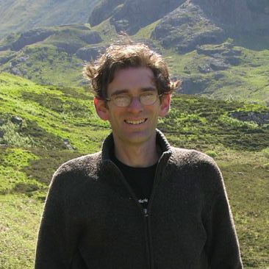
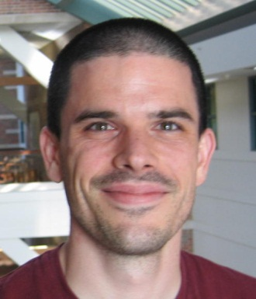
TR&D2: Subcellular-to-Cellular Modeling
September 17, 2015
Year 3 -> Year 4
Co-Investigators
Group Leaders
Terrence J. Sejnowski, PhD
Professor & Laboratory Head
Comp Neurobiology Laboratory
Francis Crick Professorship
Salk Institute for Biological Studies
Tom Bartol, PhD
Staff Researcher, Salk Institute of Biological Studies
James. R. Faeder, PhD
Associate Professor,
Comp & Systems Biology,
School of Medicine, Pitt
Markus Dittrich, PhD
Director, Biomedical Applications Group
Pittsburgh Supercomputing Center, Carnegie Mellon University

Slide 2
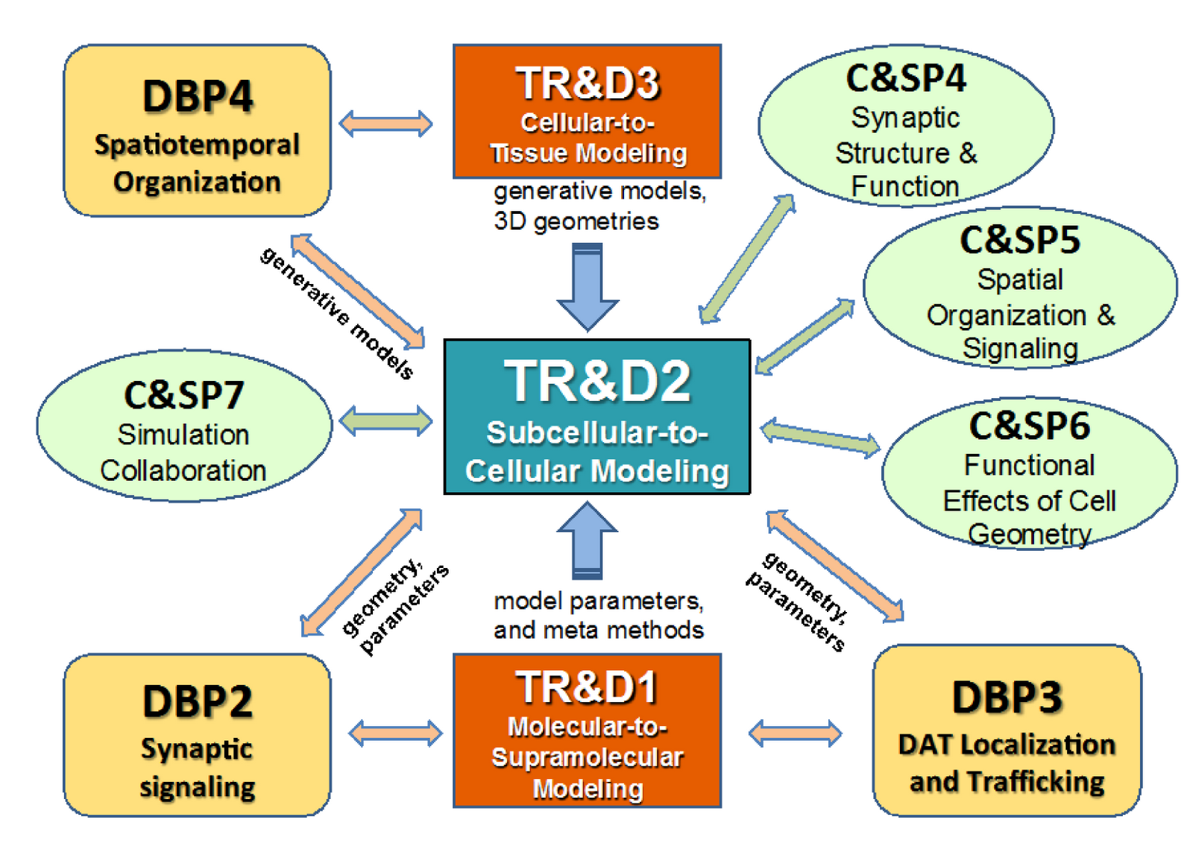
Role of MCell in the BTRC
TRD2 (Faeder and Sejnowksi)
Notes:
MCell occupies a central role in our proposed center.
TRD2 bridges the molecular scales probed in TRD1 and the cellular and tissue scales probed in TRD3.
It provides the infrastructure for cell level modeling taking data generated by our two other TRDs as input, and provides simulation capabilities that are needed by our DBPs, collaborators, and the broader cell modeling community.

Slide 3
Agenda for TR&D2 Presentation
Overview of TR&D2 and DAT trafficking model – Jim Faeder (30 minutes)
CaMKII activation in dendritic spines – Tom Bartol w/ Mary Kennedy (via Skype)
CellBlender, advances in mesh generation– Tom Bartol – Salk (20 minutes)
Calcium release in the NMJ – Steve Meriney – U. Pitt (10 minutes)
DBP3
TRD1
TRD3
DBP2
CSP6
CSP4

Slide 4
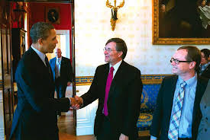
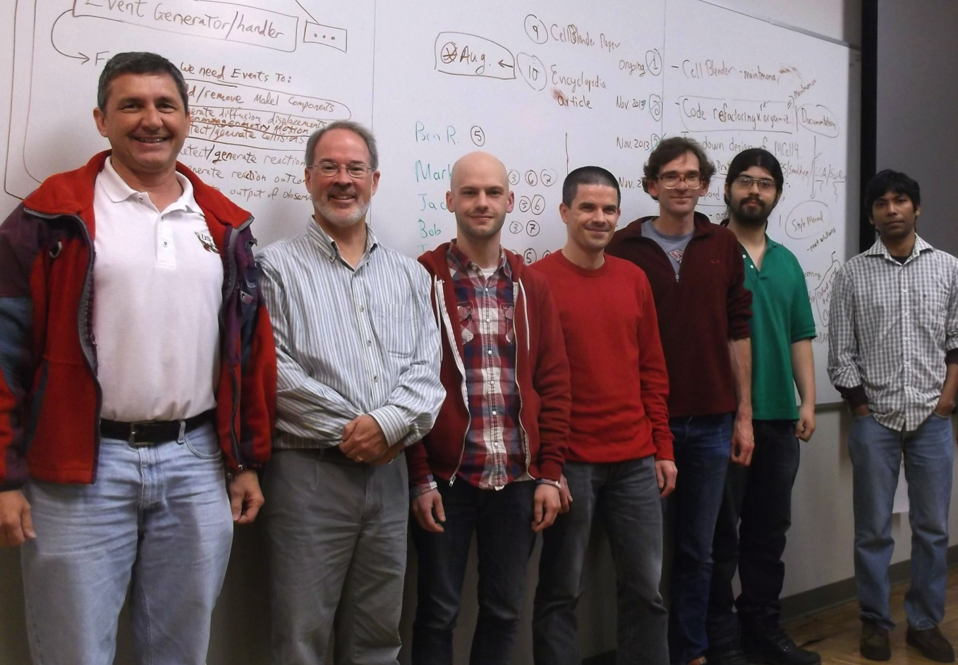

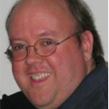

The TR&D2 Team – Year 3
Terry
Sejnowksi
Jim
Faeder
Dipak Barua
Rob Clark
John Sekar
Bob
Kuczewski
Tom
Bartol
Jacob
Czech
Markus
Dittrich
Jose-Juan
Tapia

Slide 5
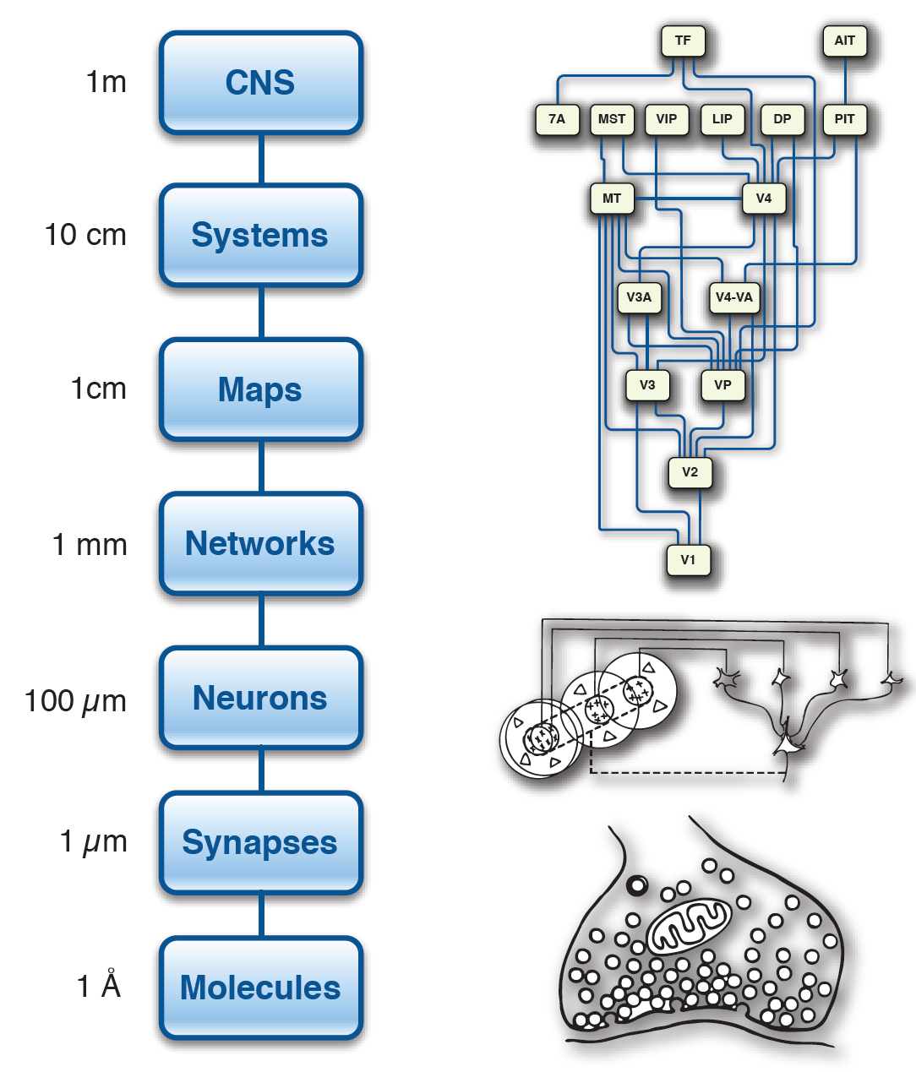
TRD2 (Faeder and Sejnowksi)
Levels of Investigation

Slide 6
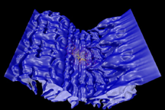
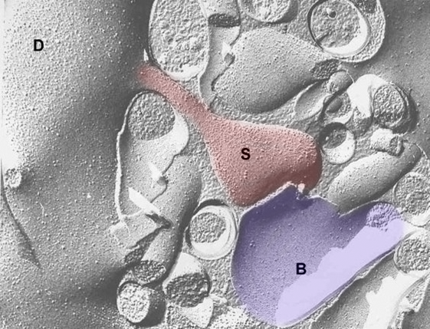
MCell
TRD2 (Faeder and Sejnowksi)
Monte Carlo Simulator of Microphysiology
Random walk diffusion
Realistic 3D Geometry
Stochastic biochemical kinetic state transitions

Slide 7
MCell Features
TRD2 (Faeder and Sejnowksi)
MCell is a critical component of the MMBioS because of its unique combination of modeling, simulation, and visualization capabilities
Particle-based, stochastic
Arbitrarily complex 3D geometry
Complex reaction networks
High-level, flexible Model Description Language
Rigorously validated and highly optimized stochastic Monte Carlo methods
Powerful and extensible visualization capabilities with CellBlender
Long history of development, and user support
  >80 publications based on MCell models (see mcell.org)

Slide 8
Specific Aims
TRD2 (Faeder and Sejnowksi)
Aim 1. libMCell – Extensible software framework
  Foundation for development and validation of new simulation methods to support DBP’s and collaborations
  Facilitate usability and extensibility by user community via API
  Enhanced runtime analysis capabilities
Aim 2. CellBlender – Model building, visualization and analysis
  Build, debug and analyze models with high spatial and biochemical complexity
  Facilitate training in spatial modeling
  Improve communication with collaborators and community
Aim 3. Advanced simulation capabilities
  Dynamic geometry
  Rule-based biochemistry
  Molecular crowding
  Parallelization
CSP4
DBP2
DBP3
DBP4
CSP5
TRD3
DBP2
DBP3
CSP4-5
DBP2-4
CSP4-5
TRD1

Slide 9
Year 3 Progress - infrastructure
Aim 1. libMCell
  Code refactoring / API / test suite
Aim 2. CellBlender
  Hardened code base
  Extensive re-design
  Nearing 1.0 release
  BNGL and SBML (core, spatial) import
Aim 3. Advanced simulation capabilities
  Dynamic geometry – improved implementation
  Rule-based biochemistry – BNGL-to-MDL translation, Atomizer
  Molecular crowding – integration of existing code
  Parallelization – integration of existing code / CellBlender
TRD1
  Weighted ensemble (rare event sampling) for compartmental / spatial models
TRD3
  Spatial modeling pipeline

Slide 10
TRD2 (Faeder and Sejnowksi)
Aim 1: Re-engineer MCell as libMCell
libMCell will
implement better support for community standards (SBML)
provide extensive suite of validation and benchmark tests
significantly enhance our ability and flexibility to implement new functionality.
enhance the ability to analyze and adjust models at runtime.
provide an API for spatial stochastic simulation research
be callable from native C and Python
facilitate interfacing with CellBlender
C&SP7
C&SP10
Progress to date:
Work on MCell code base refactoring is ongoing.
Proof of concept API for geometry, molecule and reaction creation is in place. Basic simulations can already be run programmatically.
We have continued to improve the new MCell test-suite and added many more tests. This has enabled us to maintain code correctness and accuracy as we continue our work on libMCell and other new MCell features such as dynamic geometries and MCell parallelization.
“Perhaps the most valuable feature to us will be the proposed programmable MCell API that will allow customization of core MCell features and the addition of our own data input/output routines. Indeed, we have already done this in a limited way by writing our own code to read and analyze some of the binary output files from MCell.”
Charles Nicholson, PhD
NYU School of Medicine

Slide 11
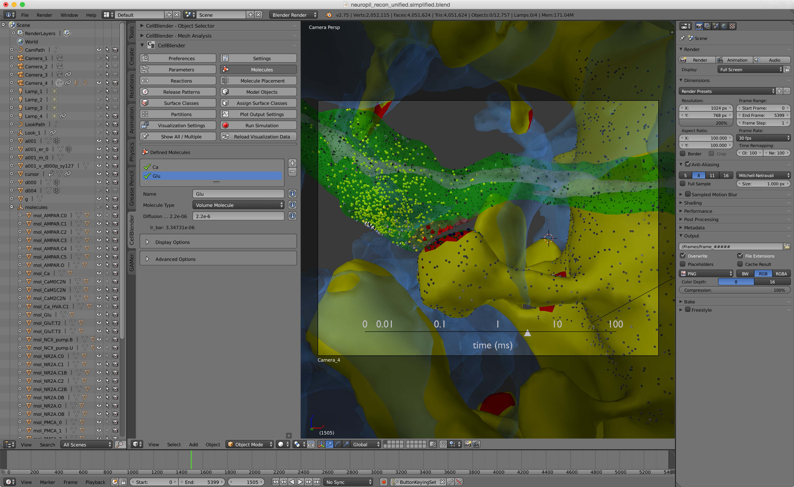
Aim 2: CellBlender
TRD2 (Faeder and Sejnowski)
Environment for Model Building, Visualization and Analysis
DReAMM needed to be replaced because of reliance on OpenDX
Blender
Highly capable 3D content creation suite
Highly customizable via Python API
Open source / cross platform
Well documented / highly optimized
Model-View-Controller architecture
Subaims / Workflow
Geometry Construction
Biochemistry Construction
Results Analysis and Visualization
Simulation Control
CellBlender 1.0
Notes:
Need to keep this brief!

Slide 12
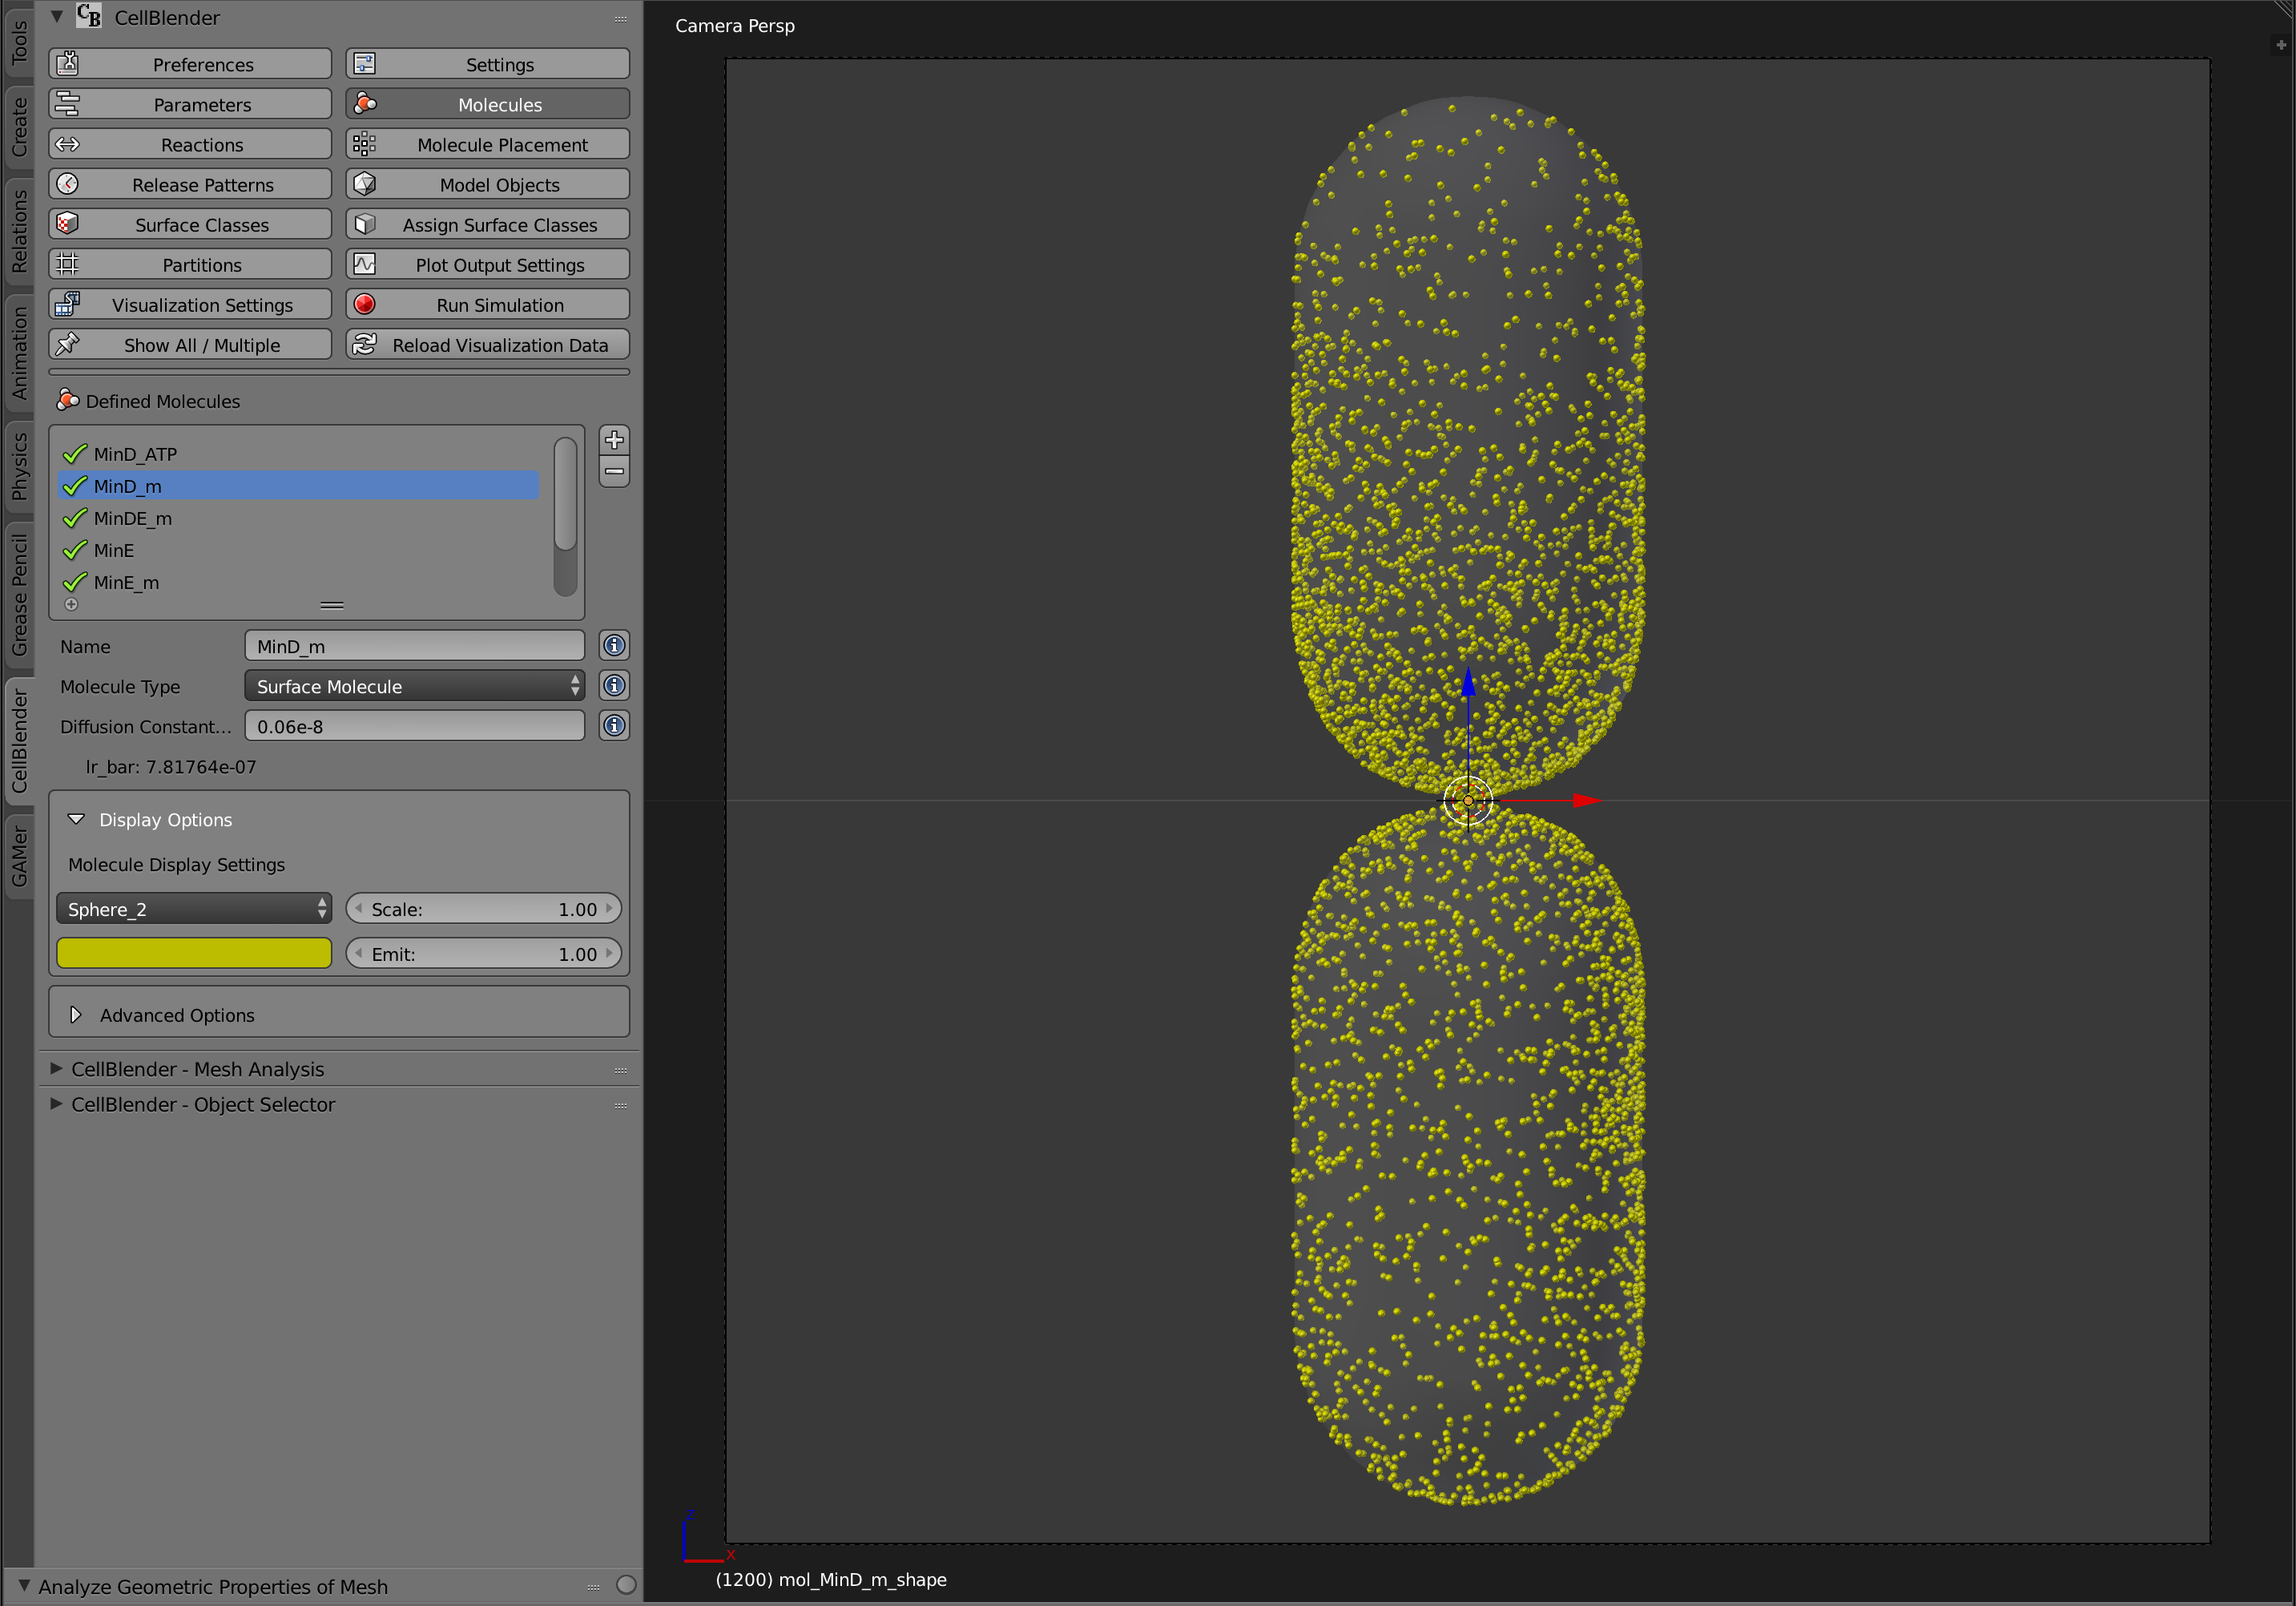
Progress for Year 3: CellBlender 1.0
TRD2 (Faeder and Sejnowski)
GUI-driven creation, simulation, and visualization of MCell models
Code hardening, parameters, data model, help system – Bob K.
Extensively redesigned workflow/interface
Multi-threaded/multi-core simulation control
Run progress/error monitor
Demo by Jacob Czech
Highlights
Model creation/editing in single product file
Simulation execution and visualization
Plotting
Import/Export of SBML for reaction networks
Import of BioNetGen for rule-based networks
Open source: http://github.com/mcellteam/cellblender
Cornerstone of MCell workshops and online tutorials

Slide 13
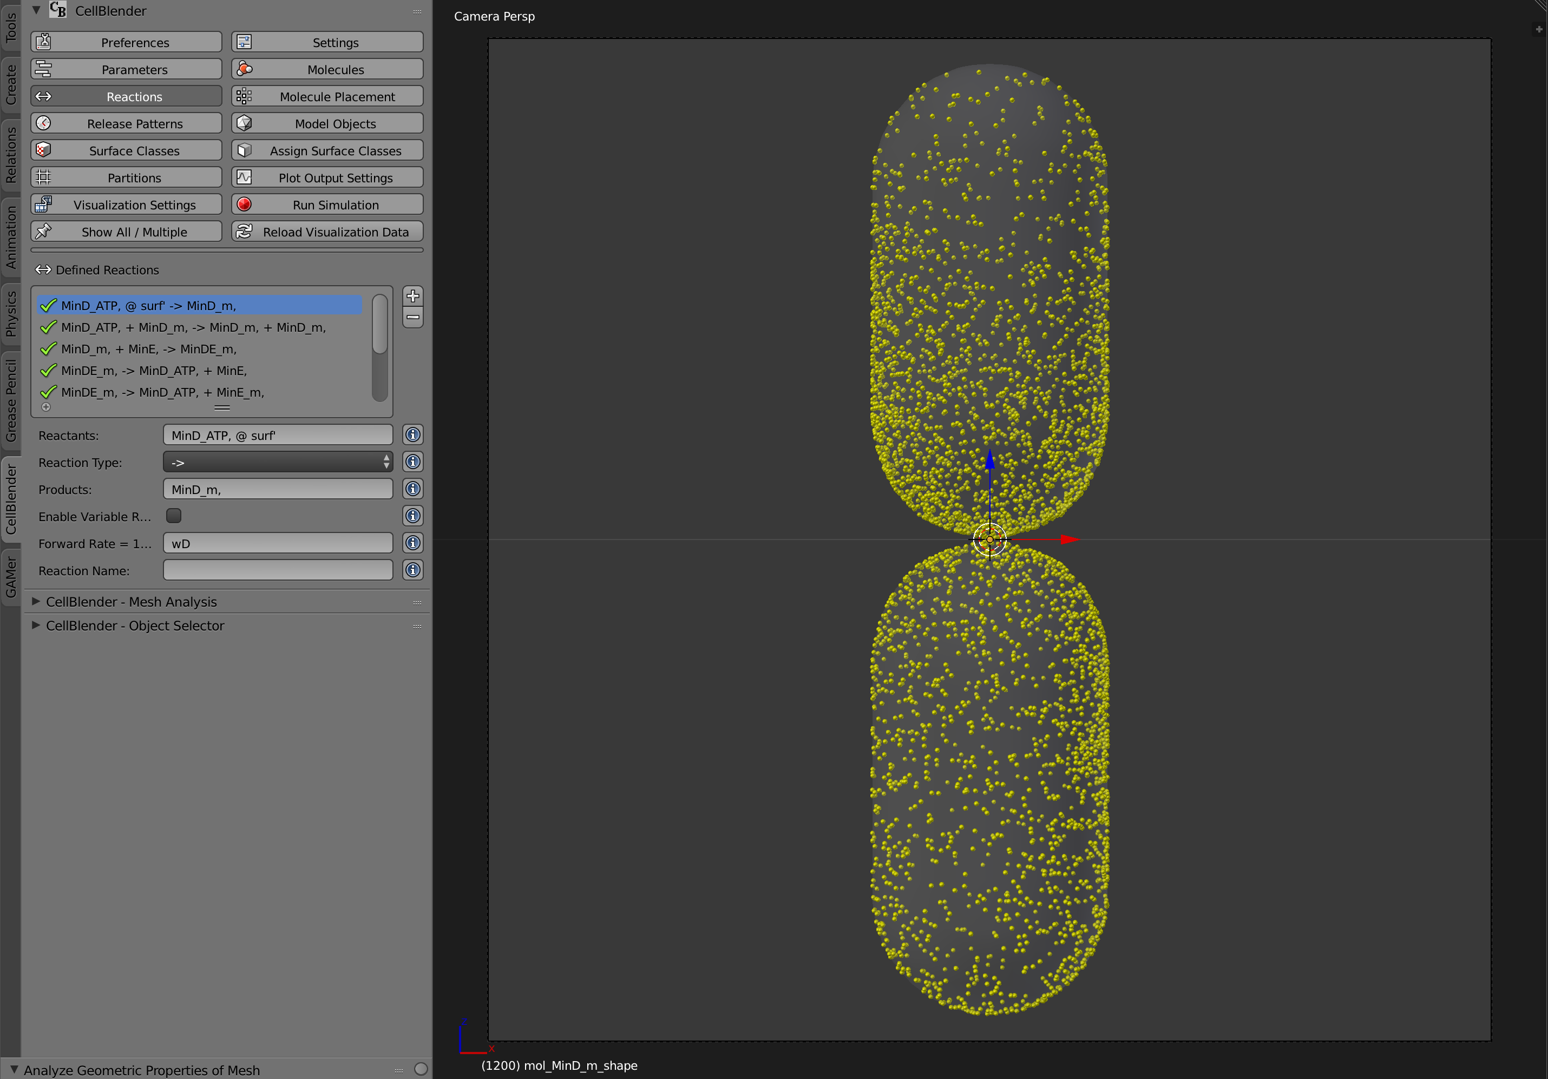
CellBlender tool bar

Slide 14
Aim 2: Plans for Year 4
Application Note on CellBlender
Integration with libMCell, Full MDL support
Planned improvements
  Averaging and parameter scans (in parallel)
    See also Aim 3.4
  Automatic (or facilitated) setup of optimizations
  Workflow for creation of moving boundaries
  Support for BNGL species/reaction specification

Slide 15
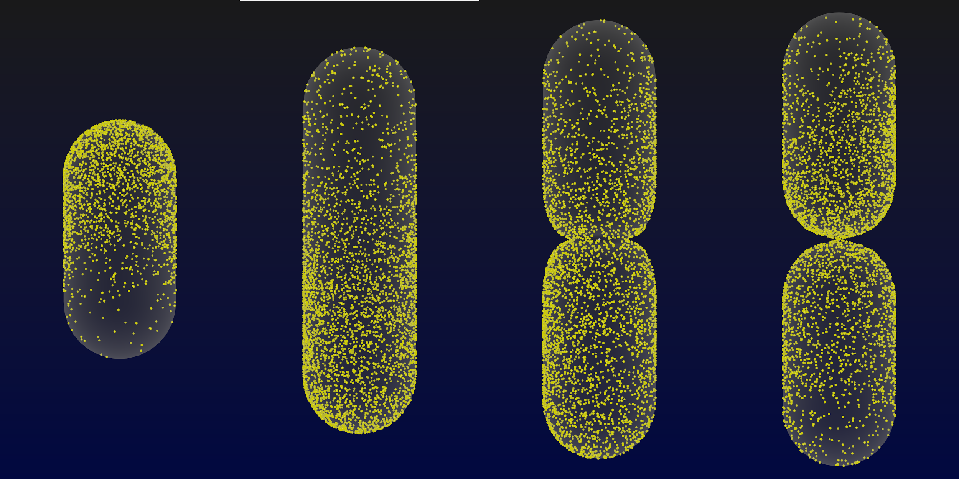
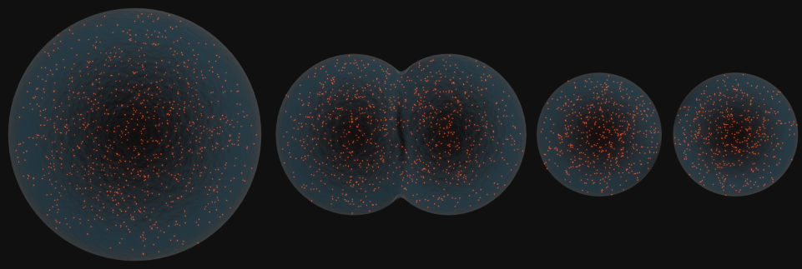
Aim 3.1: Dynamic Mesh Geometries
TRD2 (Faeder and Sejnowski)
Goal: Extend MCell simulation capabilities to allow dynamic geometries.
- endocytosis and trafficking (DBP3)
- changes in spine geometry (DBP2)
- vesicle fusion (C&SP4)
- generative models (TR&D3)
- immune synapses (DPB4, C&SP5)
Changes in mast cell shape upon activation
“We're particularly excited by the prospect of the development of dynamic mesh geometries and space filling molecules. These features will be very useful in our upcoming study of mitochondria-SR junctions, which typically appear much more dynamic than PM-SR ones.”
Professor Cornelis van Breemen, DVM, PhD
Nicola Familia, PhD
U. British Columbia
Snapshots from simulation of E. coli cell division

Slide 16
Aim 3.1: Dynamic Mesh Geometries
TRD2 (Faeder and Sejnowski)
Overview of Process
User creates a series of mesh snapshots along with a file scheduling the time they will be used by MCell
As the simulation runs, MCell reads in and replaces existing meshes at the scheduled time
After swapping meshes, molecules are moved as needed so that they don’t change compartments

Slide 17
Aim 3.1: Dynamic Mesh Geometries
TRD2 (Faeder and Sejnowski)
Progress
Improved error handling
Handling of object appearance and disappearance
Initial user documentation
Tested on E. coli MinD/E pathway during cell division

Slide 18
E. Coli MinD/MinE Pathway and Cell Division with MCell

Slide 19
Aim 3.1: Dynamic Mesh Geometries
TRD2 (Faeder and Sejnowski)
Future Plans
Couple geometry changes to variables other than time (e.g. molecule concentration)
Smarter molecule placement to reduce clustering effects
Increase robustness through additional tests
Improve efficiency of algorithm

Slide 20
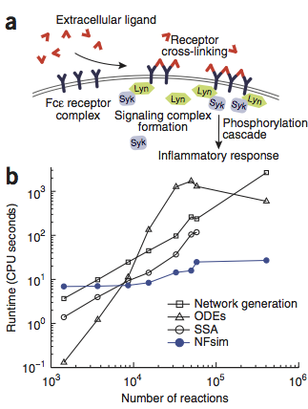
Aim 3.2: Rule-based modeling
TRD2 (Faeder and Sejnowksi)
Network-free simulations overcome combinatorial complexity by instantiating molecules and using rules to generate events
Rules provide a concise and scalable way to specify the biomolecules and biochemical interactions that give rise to large networks of species and reactions.
Goldstein et al. (2004) Nat. Rev. Immunol.
BioNetGen is a language and simulation engine for rule-based modeling
Faeder et al. (2009) Meth. Mol. Biol.
Sneddon et al. (2011) Nat. Methods

Slide 21
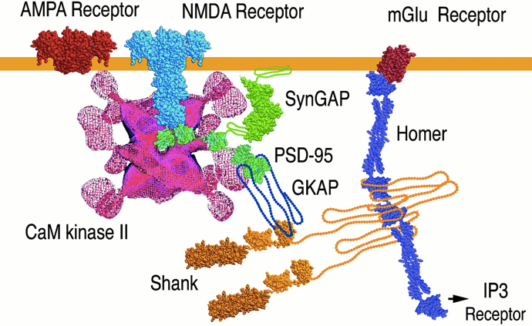
Aim 3.2: Rule-based modeling
TRD2 (Faeder and Sejnowksi)
Goal: Extend MCell to support rule-based description and network-free spatial simulation of biochemical networks.
0. BioNetGen-to-MCell model translator
1. Extension of MCell MDL syntax and data structures for structured molecules and rules
2. Network-free simulation within MCell
3. Optimization
Molecular machines in the PSD
Estimated number of states of CAMKII-CaM complexes:
40¹²
DBP2
The development of rule-based languages and rapid advances in simulation technology “are the harbingers of an entirely new way of representing and studying cellular networks. We predict that within a decade these methods will be mainstream components of quantitative biology. ”
Sorger and Bachman
Nature Methods, February, 2011.

Slide 22
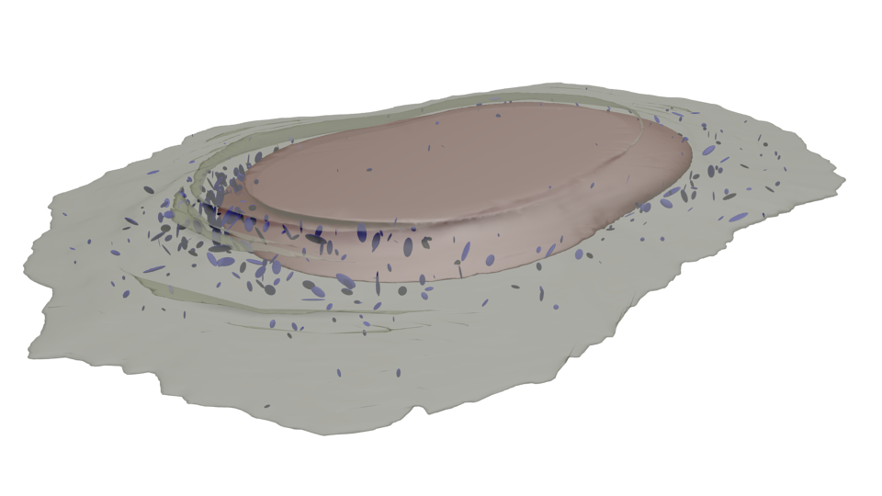
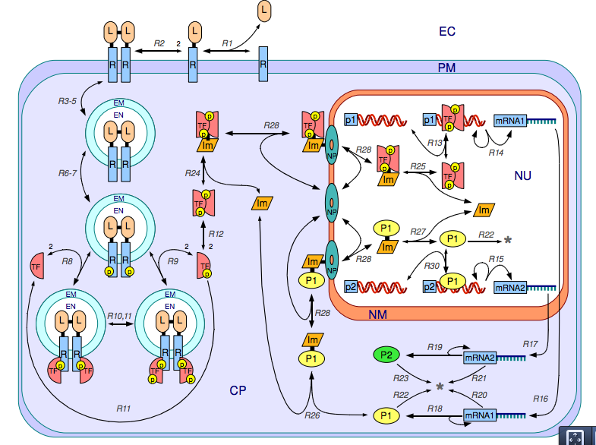
Aim 3.2: Rule-based modeling
TRD2 (Faeder and Sejnowksi)
Progress
  BioNetGen-to-MDL translator
  Modeling pipeline
    Geometry->Spatial SBML
    cBNGL ->Core SBML
  Atomizer
    Infers molecular structure from “flat” reaction network model description
  Network visualization
    Visualizing the regulatory structure of rule-based models

Slide 23
Spatial modeling pipeline
D. P. Sullivan, J. J. Tapia, et al. GLSVLSI’15, 2015.

Slide 24
Systematic investigation of spatial effects in realistic geometries
Detailed biochemical model
Realistic spatial geometries derived from images
Colors correspond to geometries drawn from different regions of cellular shape space

Slide 25
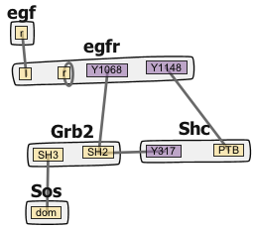
Automating structure extraction
“Atomization”
Motivation
Find molecules and interactions
Reveal the implicit assumptions
Find out what has been modeled?
Study relaxation of model assumptions

Slide 26
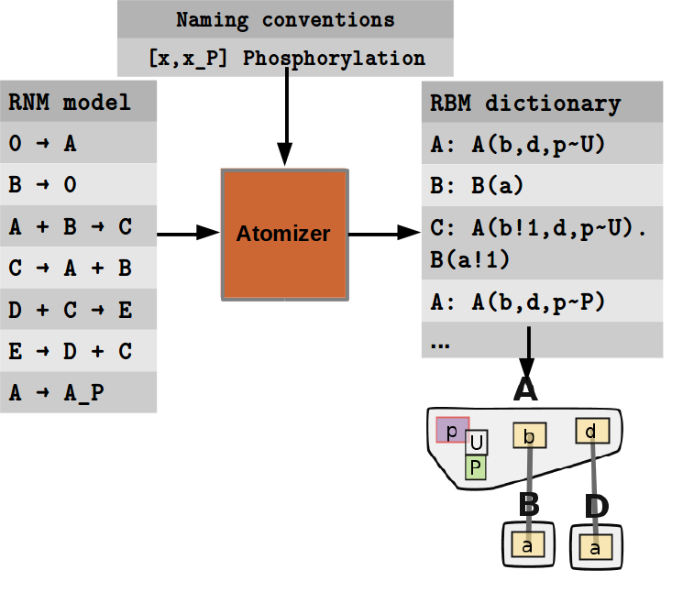
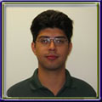
How Atomizer works
Reaction stoichiometry
Naming conventions
Annotation
José Juan Tapia
Tapia and Faeder (2013) Proc. ACM-BCB. Extended manuscript in preparation.

Slide 27

Application of Atomizer to BioModels
Large database of SBML models
>500 curated models
+ larger number of non-curated

Slide 28
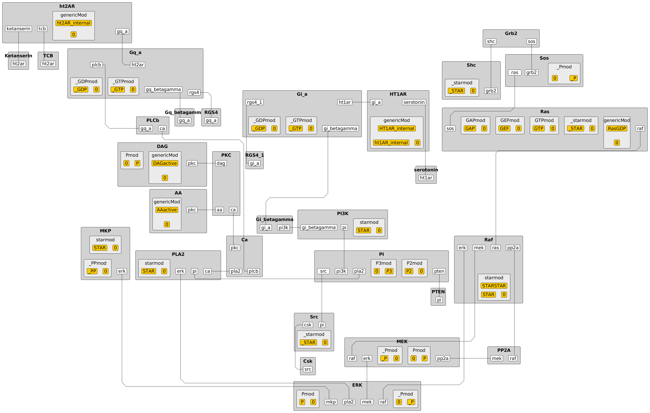
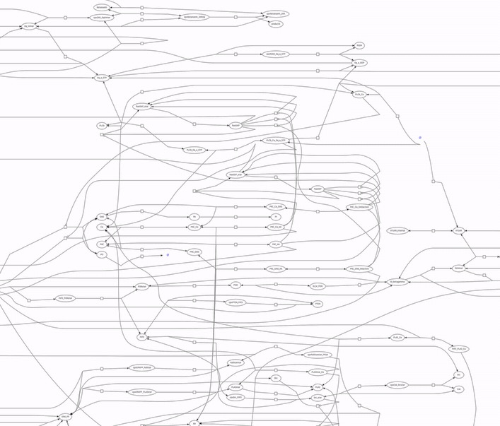
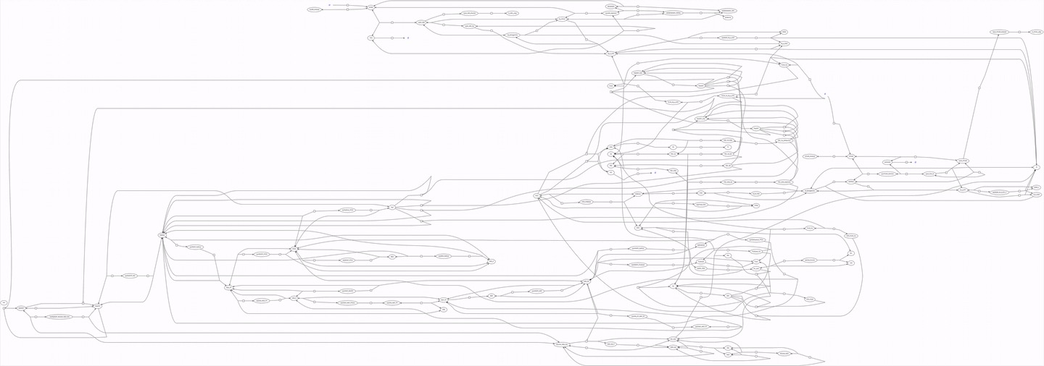
Example
Chang CW, et al. (2009). Towards a quantitative representation of the cell signaling mechanisms of hallucinogens: measurement and mathematical modeling of 5-HT1A and 5-HT2A receptor-mediated ERK1/2 activation. Neuropharmacology, 56 Suppl 1, 213-225.

Slide 29
Visualizing Rule-Based Models
John Sekar and Jose Juan Tapia

Slide 30
Visualizing Rules
It is difficult to obtain a comprehensive understanding of a set of rules
John Sekar and Jose Juan Tapia

Slide 31
Visualization using regulatory graphs
Rule set
Full regulatory graph
Compressed regulatory graph
C.-F. Tiger, et al. (2012) A framework for mapping, visualisation and automatic model creation of signal-transduction networks, Mol. Syst. Biol., 8,1–20.
Graphs drawn using yEd

Slide 32
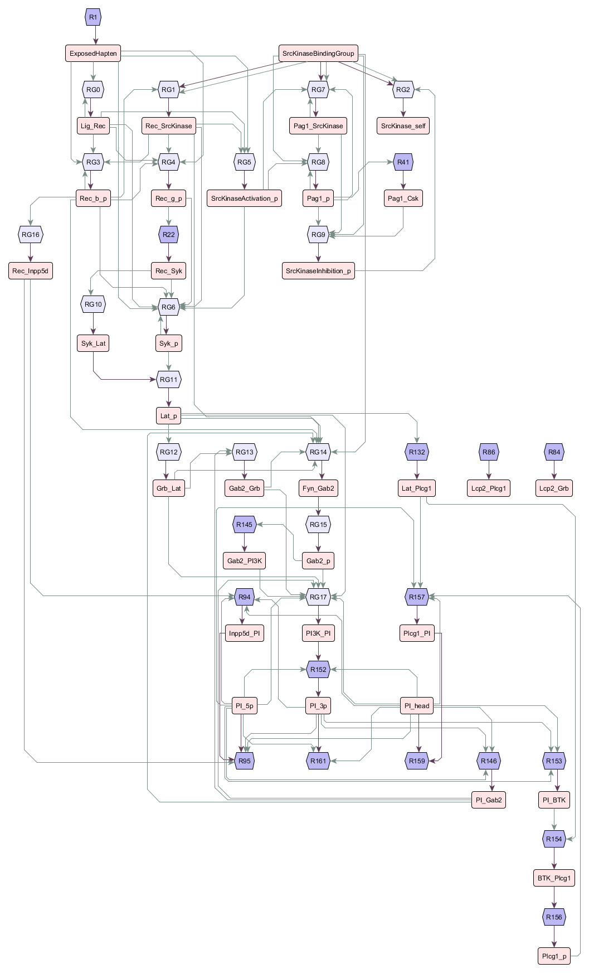
Regulatory graphs enable visualization of large scale models
17 molecule types, 162 reaction rules
L. A. Chylek, et al. (2014) An interaction library for the FcRI signaling network, Front. Immunol., 5, 1–42.
J. A. P. Sekar, J.-J. Tapia, and J. R. Faeder, “Visualizing Regulation in Rule-based Models.” Submitted to Bioinformatics. arXiv:1509.00896 [q-bio.QM].

Slide 33
Aim 3.2: Rule-based modeling
TRD2 (Faeder and Sejnowksi)
Plans for Year 4
  Develop database of Atomized models and visualizations
  Explore relaxation of Atomized model assumptions
  Participate in implementation of SBML Multi standard
  Implementation of network-free simulation within MCell
    (Extend) internal data structures for structured molecules and species graph representation
    Extend reaction event generation to include rules

Slide 34
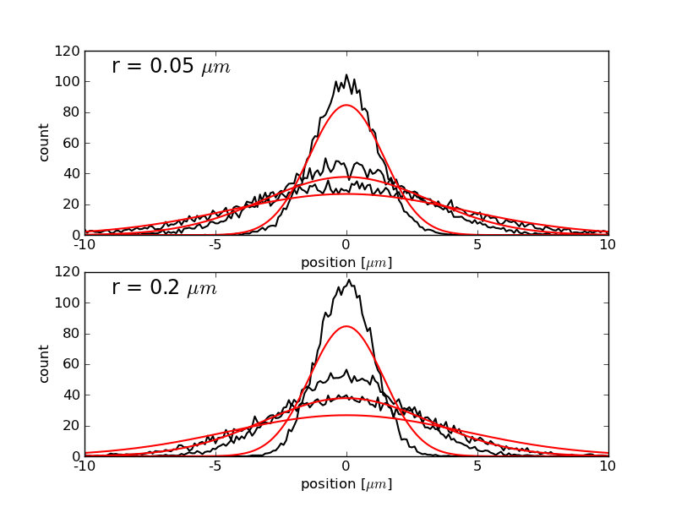
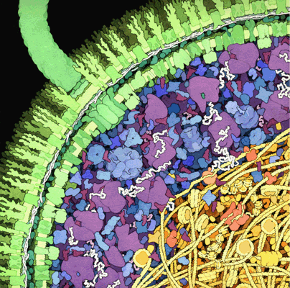
Aim 3.3: Space-filling Molecules
TRD2 (Faeder and Sejnowksi)
Goal: Account for spatial effects arising from volume exclusion on diffusion and reaction thermodynamics in subcellular simulations.
Preliminary results for diffusion of space-filling molecules in MCell using the Bullet library for collision detection. f=0.24 for lower simulation is typical of cytoplasm.
“In particular, we are very excited about two features, dynamic mesh geometries and space-filling molecules. These new features would all us to test our recently developed hypothesis on fluidity of brain structure under physiological and pathological conditions and on a transport of macromolecule- and particle-based drug carriers.”
Sabina Hrabetova, MD, PhD
SUNY Downstate
Escherichia coli as illustrated by David Goodsell.

Slide 35
Aim 3.3: Space-filling Molecules
Plans for Year 4
  Integrate experimental code based on Bullet library into main branch
  Implement collision detection for surface molecules
  Apply to specific test problems
Tarantino et al. (2014). TNF and IL-1 exhibit distinct ubiquitin requirements for inducing NEMO-IKK supramolecular structures. J. Cell Biol. 204, 231–45.

Slide 36
Aim 3.4: Parallelization
TRD2 (Faeder and Sejnowksi)
Goal: Integrate parallel simulation capabilities.
SMP (multi-core) version of MCell3
Parallel asynchronous execution for distributed memory machines.
Other HPC capabilities
Simulation control for running simultaneous trajectories – parameter sampling, distributions (Aim 2.4)
Super-linear computation through Weighted Ensemble (TR&D1)
“The simulations I am currently running require several weeks of execution time on the supercomputer on my campus. A parallel processing option would save me a lot of time and allow me to simulate scenarios that are too time-consuming to consider at present.”
James P. Dilger, PhD
Stony Brook U. School of Medicine
“… the ability to parallelize simulations would allow many, many extensions that would be otherwise difficult or impossible to implement.”
Cian O’Donnell, PhD
University of Edinburgh

Slide 37
Aim 3: Parallelization of MCell
We have developed an early prototype of a shared memory parallel version of MCell3 using POSIX threads:
  Parallel MCell code is functional for diffusing and reacting volume molecules but requires additional testing, optimization and tuning.
  Parallelization efforts will be extended to surface molecules within the next 6-8 months.
  We are also working to implement general BioNetGen and MCell implementations of WE using WESTPA
TRD1
Scaling results for a simple cubic 1μm³ system with 5*10⁶ diffusing A and B molecules reacting according to A+B -> C.

Slide 38
Aim 3.4: Parallelization
Develop simulation-runner for MCell/CellBlender to perform basic simulation tasks – averaging, parameter sweep – using multiple CPUs (in progress)
Integrate existing code for SMP (fine-grained parallelization) into current code
Develop general interface between MCell and BioNetGen to WESTPA (weighted ensemble code)
TRD1

