Slide 1
DBP3: Spatiotemporal model of DAT function and regulation in neurons
Alexander Sorkin, PI

Slide 2
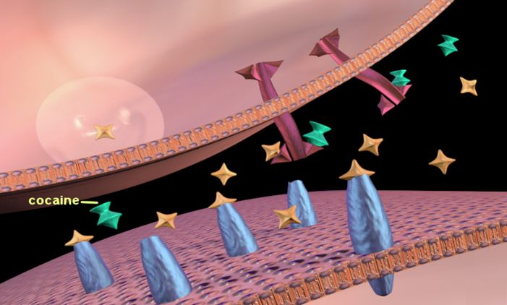
Motivation
Cihan Kaya
To understand the spatiotemporal dynamics of DA signaling.
Examine the effect of localization and concentration of DAT on signaling
Examine the effect of psychostimulant drugs on signaling
NIDA

Slide 3
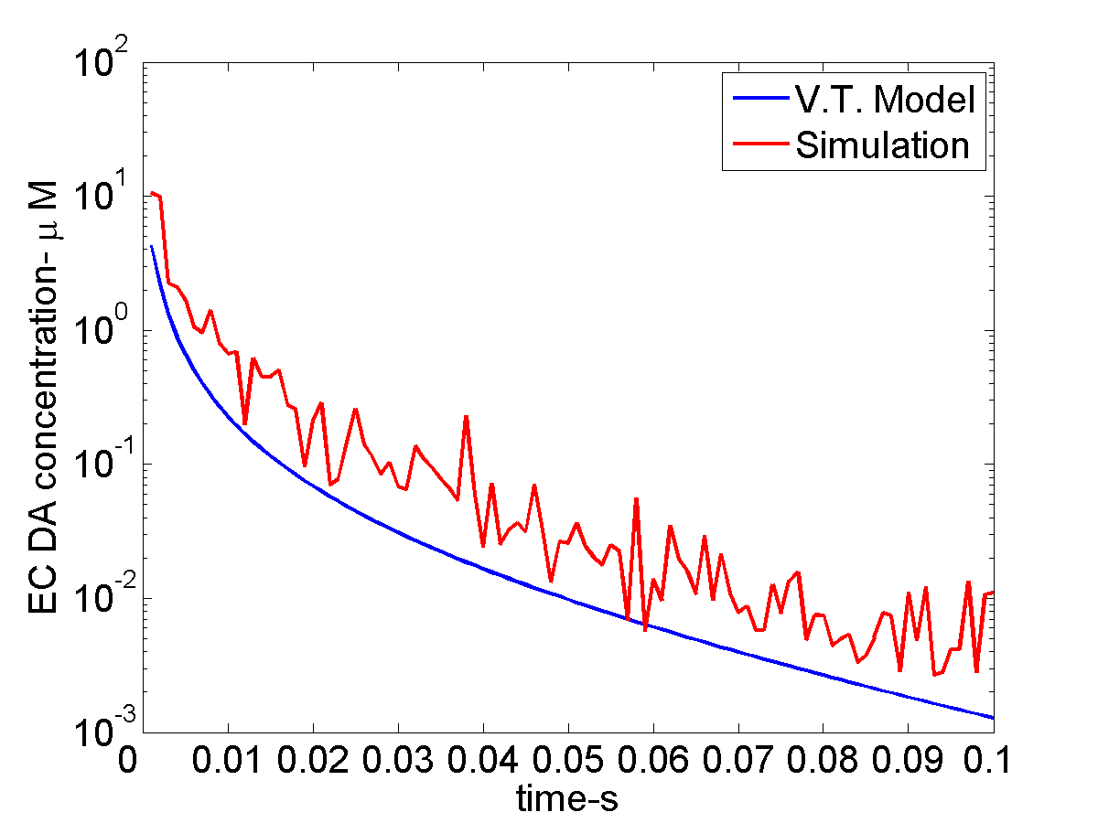
Approach
Reaction Network
MCell
Garris et. al., 1994
Output Trajectories
3D Geometry
Cardona et. al., 2012

Slide 4
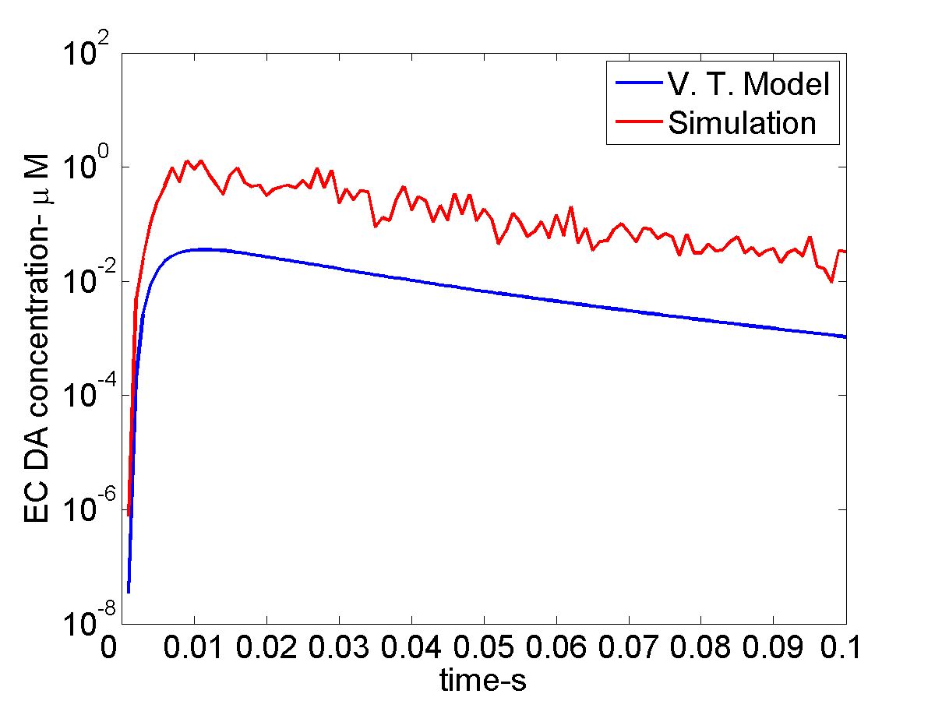
Preliminary Results
Concentration of EC DA in the sphere with center at synaptic cleft and given radius
Differences become larger away from cleft because DAT is localized there
Rice et. al., 2004.

Slide 5
Work in Progress
Reconstruction of DA synapses using fluorescence images from HA-DAT from Sorkin Lab
Test the model for different localization and distribution of DATs.
Test the model in the presence of cocaine and AMPH.
Test model under different input frequencies.
Connect DA receptor occupancy with DA release mechanism via Ca⁺⁺ channels and G-proteins.

Slide 6
Preliminary Results
5 μ
Yellow: DAT Green: DA

Slide 7
Novel capabilities for DAT modeling
More sophisticated local concentration calculations (Aim 1)
Improved workflow for geometry construction from images (Aim 2)
Moving boundaries for DAT transport to membrane and endocytosis (Aim 3.1)
Greater complexity in signal transduction (Aim 3.2)
Excluded volume effects (Aim 3.3)
Parallelization (Aim 3.4)

